Slide 1
Analyzing Insurgent Activity in Mozambique
Amanda Brotemarkle, Virginia McDaniel, Alayna Stormer
Notes:
Virginia

Slide 2
Overview
Relevant background information
Key Judgements
Driving Forces
Implications
Methods, Confidence, and Ethics
Questions
Notes:
Virginia:
Driving Forces
Violent Activities
Illegal Activities
Humanitarian Crisis
Implications
US Military
Natural Gas/Resources

Slide 3
Relevant background information
Notes:
Virginia:
Driving Forces
Violent Activities
Illegal Activities
Humanitarian Crisis
Implications
US Military
Natural Gas/Resources

Slide 4
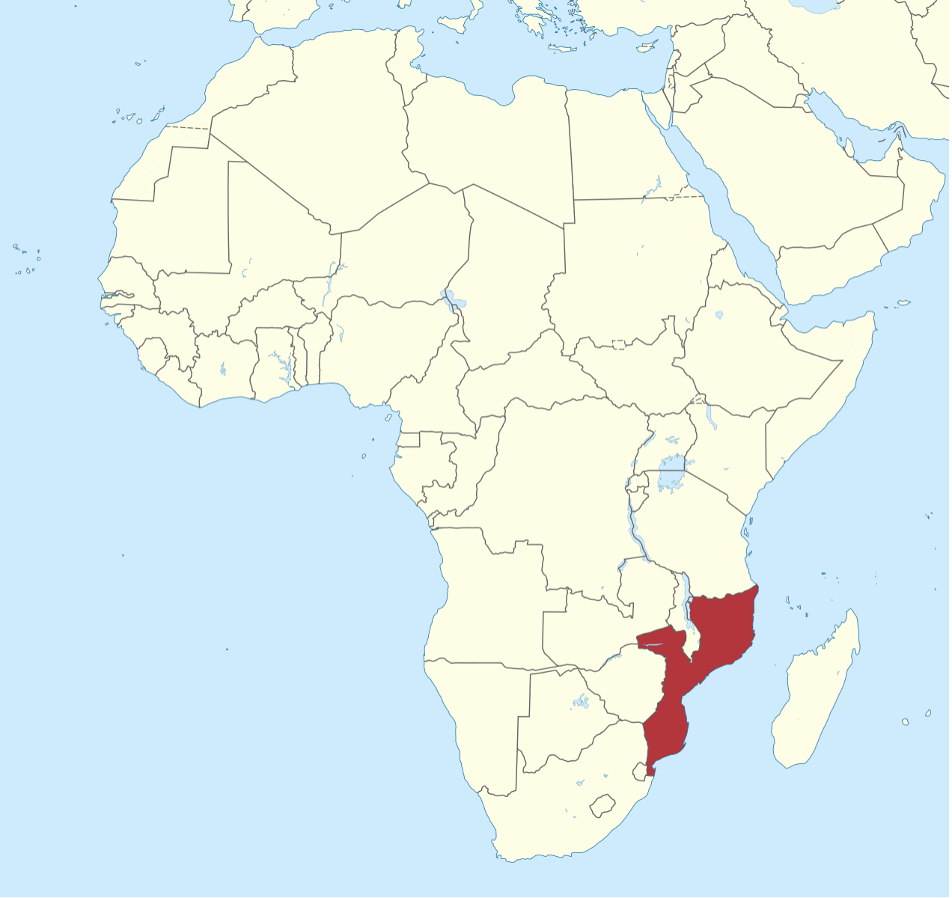
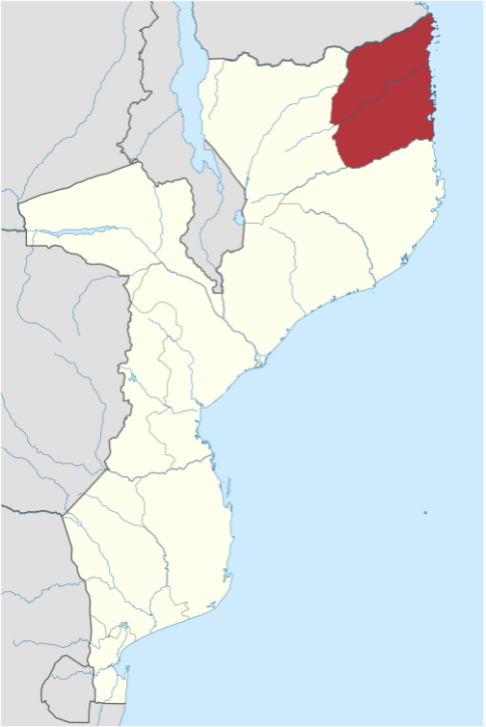
Locations
Mozambique
Cabo Delgado
Notes:
Virginia:

Slide 5
Al-Sunna Wa Jama’a (ASWJ)
https://www.dailymaverick.co.za/article/2020-03-26-islamist-insurgents-capture-second-town-in-northern-mozambique-within-48-hours/
Notes:
Virginia; insurgency group – goes by name _____; this will be the name we will use for the rest of the presentation; engages in violent actions towards civilians and infrastructure in the region; its true ideological nature is unknown, but it has been associated with known terror organizations (ISIS), but the extent of the relation between the two groups is unknown ; communication is not always consistent between ASWJ and associated groups (ISIS). Difficult to tell if the group is simply using the name of a larger organization for recognition (or in much simple terms "street cred"), in order to operate effectively, or if they are actually motivated by ISIS ideology or if they're focused on acting on local grievances.

Slide 6
Key Judgments
Notes:
Virginia:
Driving Forces
Violent Activities
Illegal Activities
Humanitarian Crisis
Implications
US Military
Natural Gas/Resources

Slide 7
Key Judgments
ASWJ is likely to continue to exercise control and pose a threat to US interests and possessions in the region due to continued violence, various illegal activities, and exploitation of regional humanitarian crises.
Notes:
Virginia

Slide 8
Driving Forces
Notes:
Virginia:
Driving Forces
Violent Activities
Illegal Activities
Humanitarian Crisis
Implications
US Military
Natural Gas/Resources

Slide 9
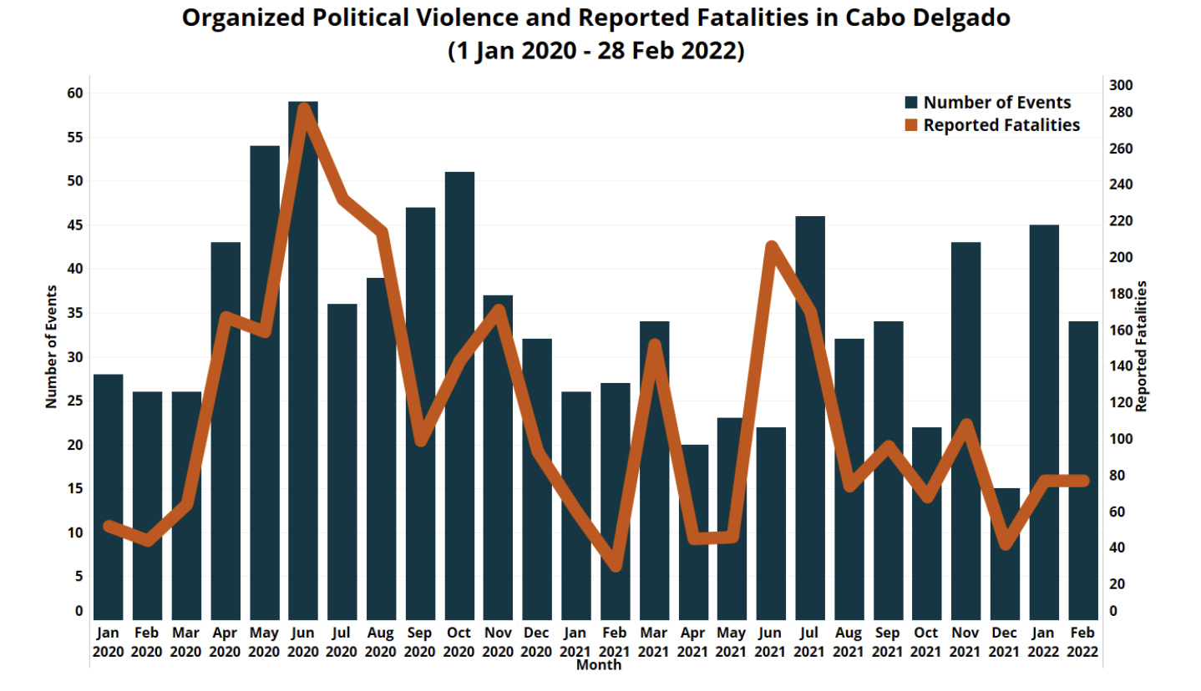
Violent Activities
It is likely that ASWJ will continue to exercise control in the province due to their past record of violence and capability of conducting large-scale attacks.
Source: ACLED
www.caboligado.com/dashboard
Notes:
Amanda

Slide 10
Violent Activities – Large Scale Attacks
Recently demonstrated both tactical and strategic sophistication in its successful attacks on major population centers and ability to wrest control of valuable territory from the government.
Mocimboa da Praia in August 2020
Palma in March 2021
Notes:
Virginia

Slide 11
Illegal Activities
Evidence of ASWJ taking advantage of...
Human Trafficking
Drug and weapon smuggling
Notes:
Virginia – to introduce, since first part is on human trafficking

Slide 12
Human Trafficking
Why?
Revenue
Is there anything being done?
Policies made
Human Trafficking Report 2021
Trafficking Victims Protection Act (TVPA)
Is it working?
Unable to enforce policies
Lack of gov't support
Weak infrastructure
Common targets
Vulnerable populations
Notes:
Likely ASWJ will use....
"Source, transit, and destination" for human trafficking
Anything being done? Yes, there have been strides – DoS Human Trafficking Report 2021 "tier 2" meaning: granted to countries that do not currently meet the Trafficking Victims Protection Act (TVPA) “minimum standards but are making significant efforts to bring themselves into compliance with those standards
Common target -> vulnerable populations

Slide 13
Human Trafficking - Victims
Child Labor
Education
Marginalization
Icons pulled from: https://www.humanitarianresponse.info/sites/www.humanitarianresponse.info/files/documents/files/mozambique_sdr_-_21_april_2019_final.pdf
Notes:
made easier by limited opportunities of victims -> gov't is attempting to grant more opportunities (female ed., ed. standards, mitigation of child labor – age raised to 15; not working – lack of enforcement)

Slide 14
Drug/Material Smuggling
There is evidence that the insurgency benefits from drug and other material smuggling through borders.
Borders between neighboring countries and Mozambique are not controlled or monitored by the Government or Police.
Heroin trade and material smuggling in Mozambique has also funded illegal actions by insurgencies and corrupt leaders.
Notes:
Alayna

Slide 15
Exploitation of Humanitarian Crises
ASWJ will continue to exacerbate and take advantage of the existing humanitarian crises within Cabo Delgado, including civilian displacement, local distrust of the Mozambican government, and continued effects of the COVID-19.
Notes:
Amanda

Slide 16
Humanitarian Crises - Displacement
It is likely that the number of displaced civilians will continue to increase and will continue to strain the province due to overcrowding and scarce resources.
Source: International Crisis Group
https://reliefweb.int/sites/reliefweb.int/files/resources/303-mozambique-cabo-delgado%20%281%29.pdf
Notes:
Amanda

Slide 17
Humanitarian Crises – Distrust for Government
Successfully exploited distrust for the Mozambican government and it is likely that this exploitation will continue as there are longstanding issues within the province.
Resettlement efforts around natural gas sites
Geographic distance from Mozambican capital
Leaders involved in illicit affairs
Notes:
Amanda

Slide 18
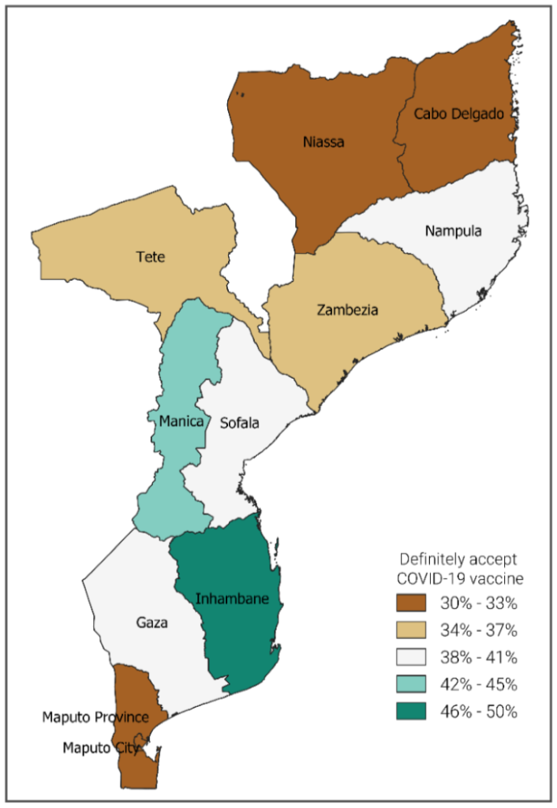
COVID-19
The insurgency has taken advantage of COVID-19's impact to the humanitarian crisis with the level of increased violent attacks.
Borders and schools closed with no virtual option.
Limited Health services, masks, vaccines, and other hygiene materials.
https://www.psi.org/2020/12/covid-19-vaccine-acceptability-in-mozambique-setting-vaccine-roll-out-programs-up-for-success/
Notes:
Alayna

Slide 19
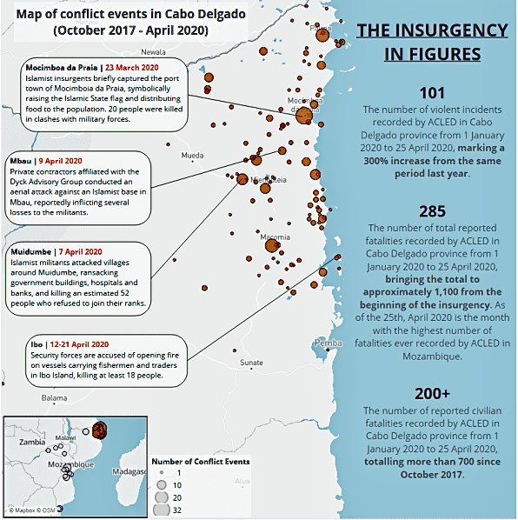
https://reliefweb.int/report/mozambique/covid-19-disorder-tracker-spotlight-concerning-escalation-mozambique-19-25-apr

Slide 20
Implications
Notes:
Virginia:
Driving Forces
Violent Activities
Illegal Activities
Humanitarian Crisis
Implications
US Military
Natural Gas/Resources

Slide 21
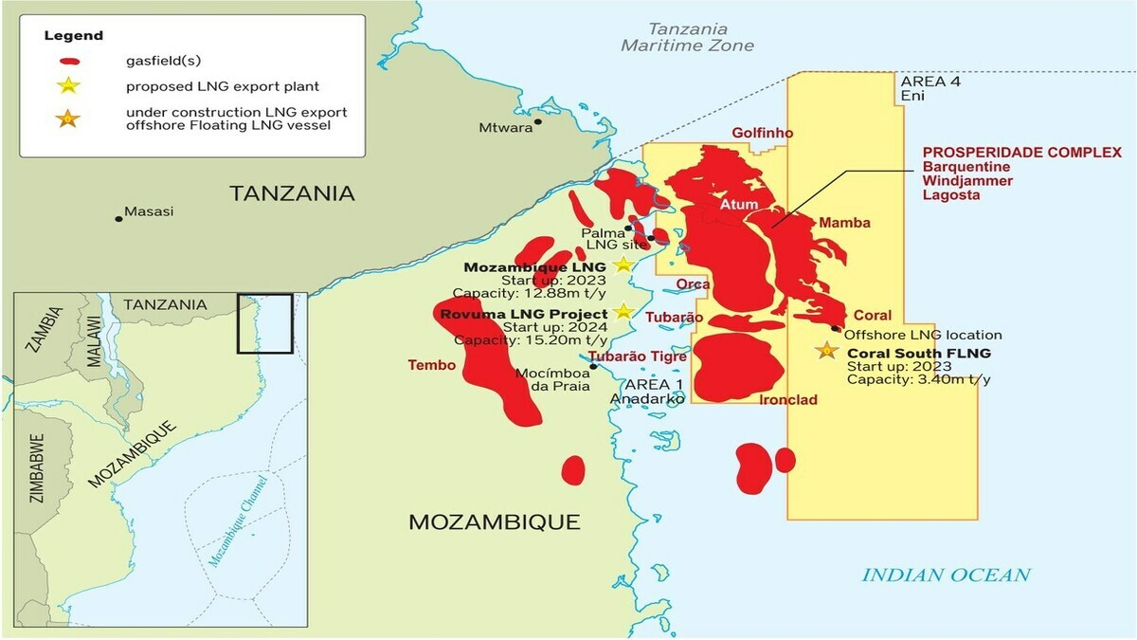
Implications of Natural Gas/Resources
Map of Natural Gas Resources/Sites
Oil and natural gas projects
Potential large source of revenue for Mozambique
https://www.rivieramm.com/news-content-hub/news-content-hub/afdb-gives-green-light-for-totals-mozambique-lng-project-56967

Slide 22
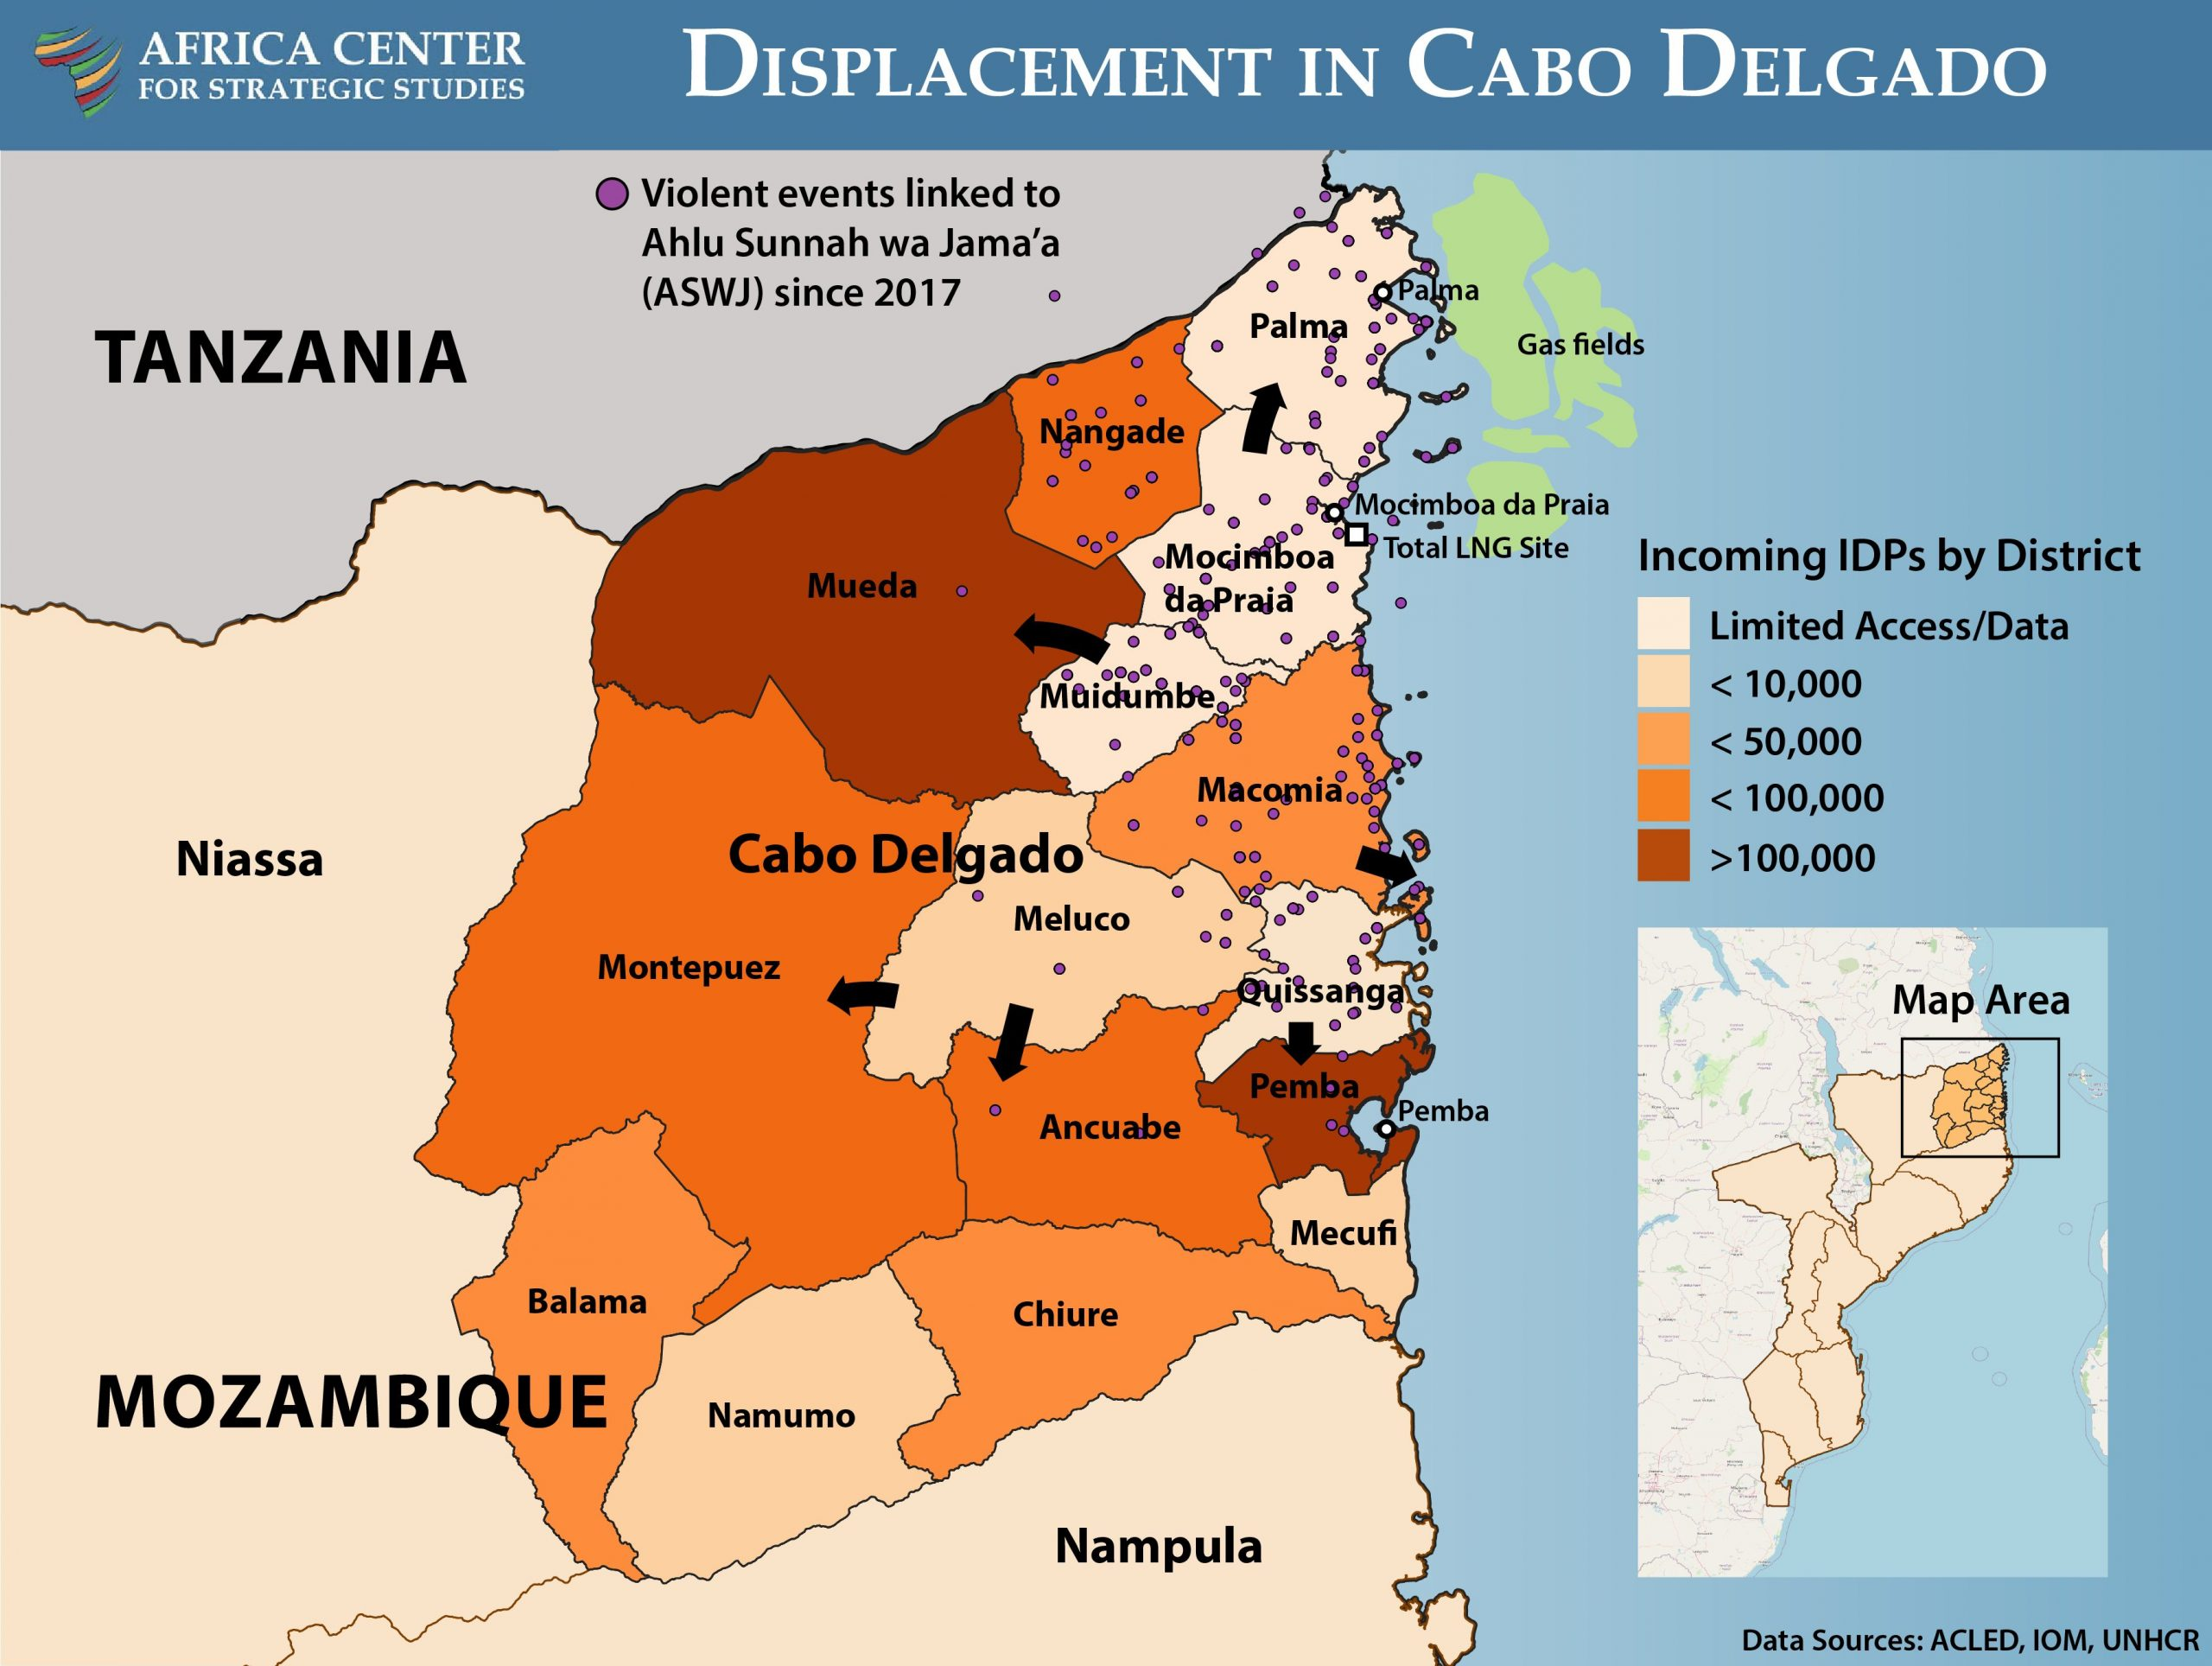
ASWJ attacks near the gas sites
Attack on Palma in March 24, 2021
https://africacenter.org/spotlight/cries-from-the-community-listening-to-the-people-of-cabo-delgado/

Slide 23
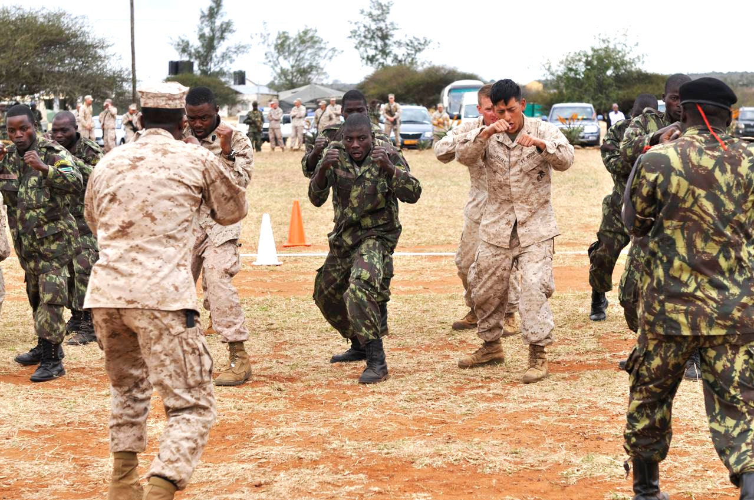
US Military Implications
US military policy and strategy is tied to this issue.
March of 2021
September of 2021
February of 2022
https://www.wired.com/2011/08/mozambique-military-training/

Slide 24
Methods, Confidence, and Ethics
Notes:
Virginia:
Driving Forces
Violent Activities
Illegal Activities
Humanitarian Crisis
Implications
US Military
Natural Gas/Resources

Slide 25
Methodology- Indicator Analysis
Notes:
Trends; tracking situation/variables over time; rest of method is on handout

Slide 26
–Methodology: Strategic Relevance Check
Evaluating where the US is involved, and how to respond
Moderately and Radically changed environments

Slide 27
Confidence Level
Moderate level of confidence in our analytical judgment that ASWJ is likely to continue to exercise control and pose a threat to US interests and possessions in Mozambique.
High quality and variety of sources to inform our analysis
Methods used
Denial and Deception encountered
Notes:
Virginia

Slide 28
Ethical Significance
Question of true ideology of ASWJ, consequentialism
Remaining objective and challenging key assumptions

Slide 29
Questions
Notes:
Virginia:
Driving Forces
Violent Activities
Illegal Activities
Humanitarian Crisis
Implications
US Military
Natural Gas/Resources

Slide 30
Acknowledgements
Thank you so much...
Dr. John Robinson
Eric O'Neill
Dr. Jeffrey Tang

Slide 31
Questions?
Amanda Brotemarkle
brotemar@dukes.jmu.edu
Virginia McDaniel
mcdaniva@dukes.jmu.edu
Alayna Stormer
stormean@dukes.jmu.edu
Notes:
Amanda

Slide 32
Our Definitions Used for...
Terrorism: Violent, criminal acts committed by individuals and/or groups who are inspired by, or associated with, designated foreign terrorist organizations or nations (state-sponsored).
Insurgency: 'the organized use of subversion and violence to seize, nullify, or challenge political control of a region
The United States has defined the group as, "ISIS Mozambique," however, it is important to recognize that while some direct correlation may exist, they have not been clearly claimed as a branch of the ISIS terrorist organization. "The International Crisis Group (IGC) think tank recently said the insurgents had only "tenuous links" with IS and the "real drivers of [this] conflict have more to do with local grievances""

Slide 33
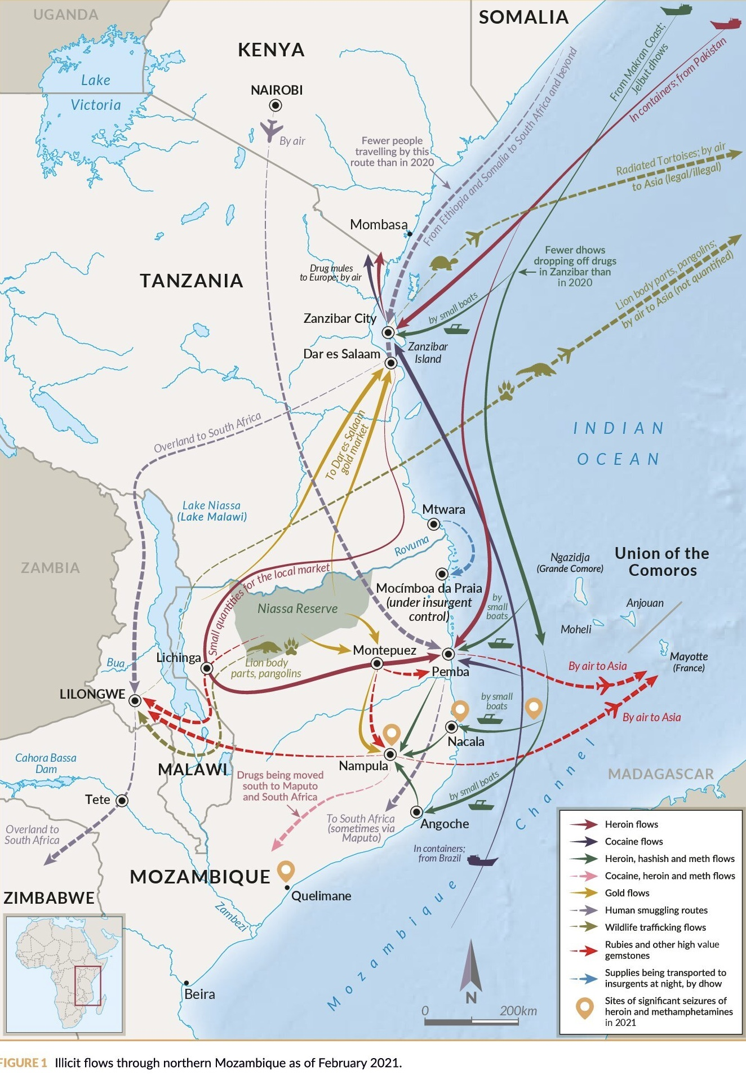
Other Material/Drug Smuggling Routes
The insurgency has shifted trade routes to more safe routes that avoid the "centralized conflict" areas in Cabo Delgado
Drugs: Heroin, Cocaine and Methamphetamine (Meth is a newer addition since 2020 and "methamphetamine on this route has increased to such an extent that more than 50% of these shipments are now made up of meth.") Article by Daily Maverick
Materials: Gold, Rubies and other gems, ivory, timber, and even wildlife. (There is little evidence of ASWJ profiting in low-level gold trade)
Mostly being smuggled by boat/shipping container coming into ports around Mocímboa da Praia, Quissanga and Pemba, Nacala and Angoche on dhow's- (a lateen-rigged ship used in the Indian Ocean)
Article: https://www.dailymaverick.co.za/article/2021-05-02-cabo-delgado-insurgency-the-shifting-shape-of-the-illicit-economy-in-northern-mozambique/
Graphic: https://www.dailymaverick.co.za/article/2021-05-02-cabo-delgado-insurgency-the-shifting-shape-of-the-illicit-economy-in-northern-mozambique/

Slide 34
More on Violent Attacks
Why the sudden increase in severity/frequency of attacks by ASWJ in June of 2020? The insurgency ASWJ has switched tactics from conducting guerrilla raids on towns to attacking larger areas with more critical infrastructure for complete control. (Starting with attack on Mocímboa Da Praia). Focused on more large-scale attacks that disrupt civilian life, critical infrastructure and the economy
Methods of attack: Attacking towns with high population, high amount of critical infrastructure, towns that are essential for trade routes and ports in attempts to gain full control of an area to be used as an operations "base" for them to operate out of. Their attacks range from explosives, firearms, beheadings, arson attacks, and destroying crops/homes/critical infrastructure buildings
Known Motives: Unclear. "Assaye Risk’s 2018 report indicates that the insurgents are more concerned with criminal activity than religious ideology."

Slide 35
Gas Projects in Mozambique
$20 Billion Final Investment decision in 2019. Initial projection of liquified natural gas being delivered was to start in 2024 from approximately 65 trillion cubic feet of recoverable natural gas include a two-train project with the ability to expand up to 43 million tonnes per annum (MTPA). Includes offshore production/extraction of natural gases
Last year, TotalEnergies halted the work on the project and declared "force majeure" due to ASWJ attacking close to the construction camp. The situation has pushed back the start of exporting LNG to at least 2025-Full production of 13.1 mtpa is currently projected to take off in 2026
The Project is operated by TotalEnergies – the world’s second largest LNG player with a leading presence in Africa
The company has been present in Mozambique since 1991
Currently the largest private investment in Africa
Mozambique LNG has already secured long-term deals with companies like Shell, EDF, CNOOC, Tokyo, JERA, and CPC
Useful Articles from Mozambique LNG: https://mzlng.totalenergies.co.mz/en/about-mozambique-liquefied-natural-gas-project and from Offshore Energy: https://www.offshore-energy.biz/totalenergies-to-resume-mozambique-lng-project-in-2022/

Slide 36
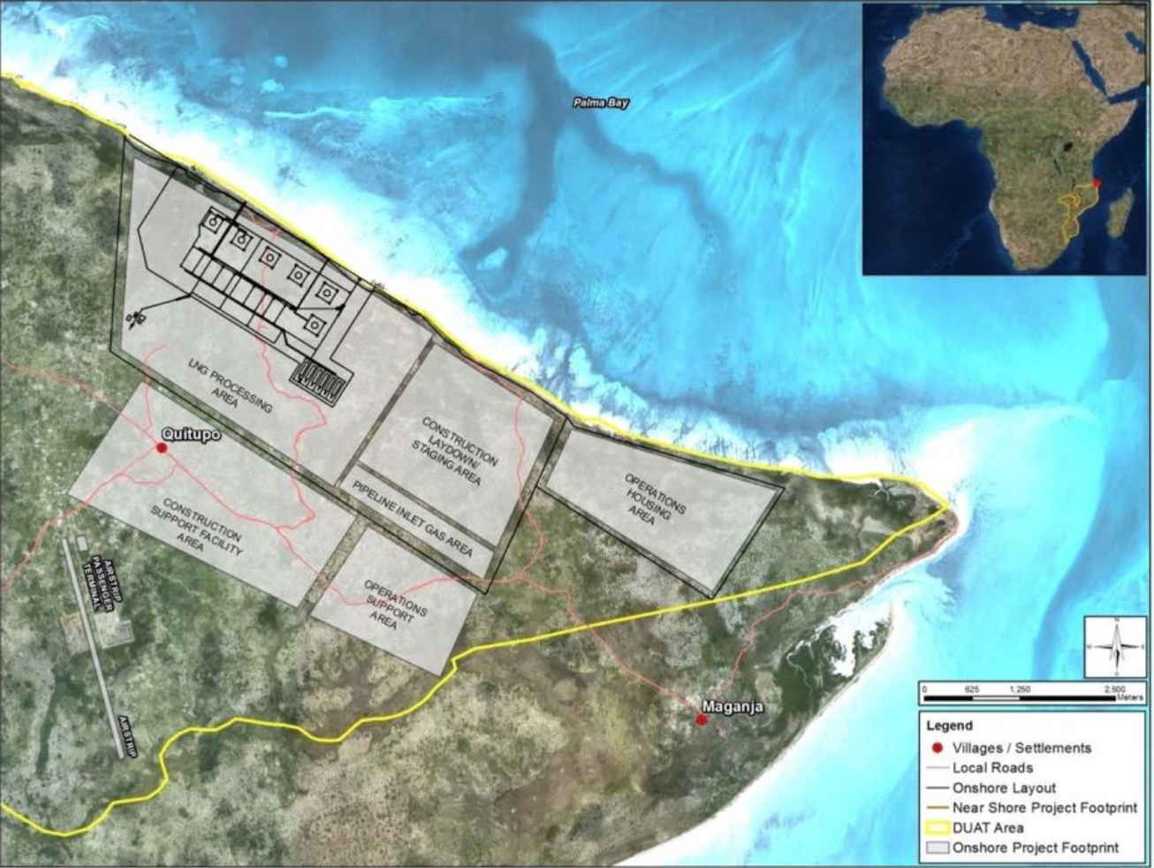
Map of Natural Gas Project
https://www.afdb.org/fileadmin/uploads/afdb/Documents/Environmental-and-Social-Assessments/Mozambique_LNG_ESIA_Summary.pdf

Slide 37
US Military Implications
An article by Anadolu Agency published on February 2nd of 2022 included this quote, "As a strategic partner, the United States is committed to ensuring our military-to-military engagements continue during such an important moment for Mozambique’s national security,” -US Ambassador to Mozambique Dennis W. Hearne
Other countries have also offered military support against the insurgency. Private military companies such as Wagner Group (Russia) and Dyck Advisory group (South Africa) offered their assistance as well
In November, the EU launched a military mission to train Mozambican troops to fight terrorism in Cabo Delgado
Since July 2021, over 3,000 Rwandan and southern African troops have deployed to Mozambique’s Cabo Delgado province
Portugal also announced they would be sending troops over for military training exercises in February of 2021
Source of Info: https://www.aa.com.tr/en/africa/us-launches-3rd-military-training-program-in-mozambique/2493624

Slide 38
Media and Denial
Mozambique's government first denied the existence of the insurgency, humanitarian crisis, and security crisis in Cabo Delgado
Forbid, limited, or prohibited media coverage on this issue
During a press conference in February 2019, Governor Julio Parruque of Cabo Delgado announced that he would “no longer tolerate” journalists covering topics such as insurgent attacks, corruption, and drug trafficking
Some like, Investigative journalist Ibraimo Mbaruco, have “gone missing” while seemingly in police custody
Tom Bowker, British co-founder of Zitamar News, was ordered to leave Mozambique in January 2021, the first expulsion of a foreign journalist in over 30 years
Source: https://theowp.org/crisis_index/northern-mozambique-insurgency/

Slide 39
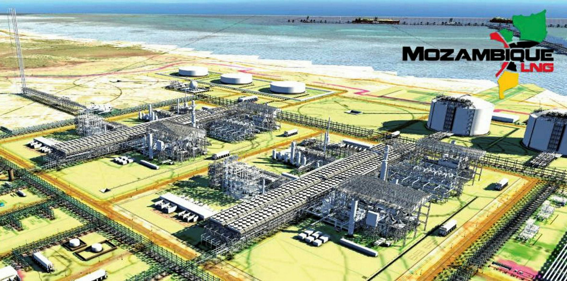
Environmental Issues
The country regularly faces increasingly severe droughts, cyclones, and floods. As many as 25% of the population faces a high mortality risk from environmental disasters (UNDP)
The carbon emissions from the onshore and offshore projects will increase Mozambique’s total emissions by at least 8 percent
Threatens "Quirimbas National Park," destroys fishing grounds, disrupts ecosystems and endangers plant/animal life
https://news.mongabay.com/2021/04/gas-fields-and-jihad-mozambiques-cabo-delgado-becomes-a-resource-rich-war-zone/
Source: https://www.ran.org/the-understory/lng-destroys-villages/

Slide 40
Other Factors
Key Economic Sectors: Agriculture, Mining, Fishing, Oil and Natural Gas
- 88% of Cabo Delgado residents work in agriculture, fishing, or forestry (UNDP 2015)
- Extractive industries (i.e. mining, oil and natural gas) are fast-growing, but generate few jobs (often with hazardous working conditions)
Literacy rate: 47% nationwide (World Bank 2018), 67% in Cabo Delgado (USAID 2020)
Population Below the Poverty Line: 55% nationwide (IGC 2019), 50% in Cabo Delgado (UNDP 2015)
Useful Source: https://theowp.org/crisis_index/northern-mozambique-insurgency/

