Slide 1
????
GE classes are not relevant to me
GE classes don’t prepare students for my class
Orientation doesn’t prepare students for university work
GE courses are too hard!
GE courses are too easy!
Hey, I’m 18
GE doesn’t prepare me to get a job

Slide 2
Preface @JMU
Gretchen Hazard & Kathy Clarke
Association for General & Liberal Studies, Portland 2012

Slide 3
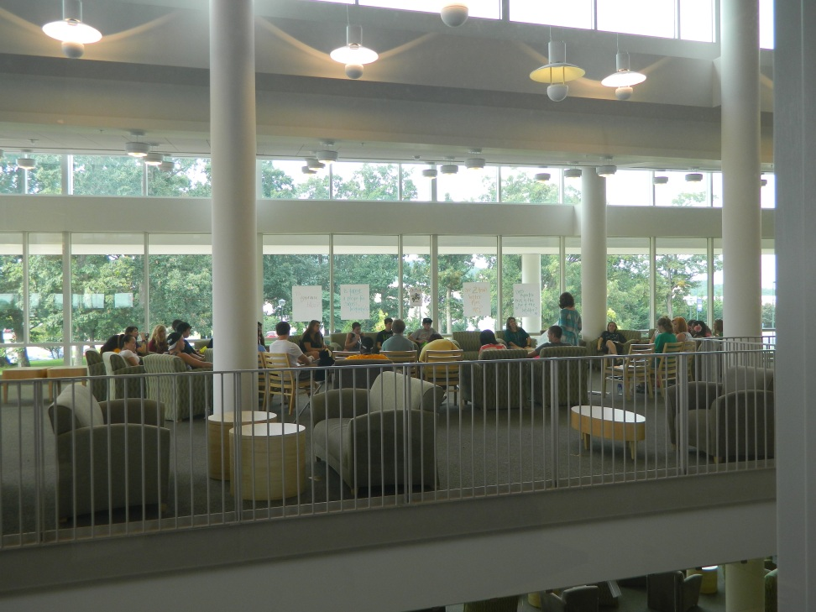
What is
PREFACE is a program designed to introduce incoming first-year students to the JMU academic culture, classrooms and expectations, using a common reading. PREFACE attempts to create a thematic discussion that can occur in settings within or in addition to the traditional classroom learning environment.
Dr. Cara Meixner’s 2011 Preface session, East Campus Library

Slide 4
Program Goals
Introduce our newest students to the academic culture and community at JMU.
Help new students understand how class preparation in college differs from high school.
Explore with new students how a general disposition of open-mindedness will contribute to their learning.

Slide 5
Pieces
Students get assignment at Summer Springboard and in OneBook
Students complete the reading
Students complete writing assignment
Students meet with a faculty member during 1787 Orientation

Slide 6
Resources
Appropriate Readings | Writing Prompt
Peer Educators | Non-traditional “class”
Collaborative | Assessment
Faculty Development Sessions | Active Learning Lab Space
Choir | 4 day Orientation
Goals/Learning Objectives | Theme

