Slide 1
Innovating in a Virtual “Classroom”
Kathy Clarke
Jenne Klotz

Slide 2
Evolution of The IL Curriculum
1984
Library Skills Workbook
31 learning objectives including differentiating between LC and Dewey and location of print periodical.
1995
Finding Information Workbook
Introduced electronic connection: “You have probably heard of the Internet.”
2000
Go for the Gold
8 HTML frames based modules with quizzes.
2013
Madison Research Essentials
5 video modules with associated quizzes. Designed for easy embedding in Learning Management System (Canvas)
Notes:
We’ve been working our way into the classroom for many years
The library and research environment has changed and the classroom has been a moving target – KC notes, somewhere in here we need to plop in the ACRL IL Standards and when they were adopted into the GE curriculurm. For the life of me I can’t find that documented in our stuff, I’ll go poke through old catalogs in a bit.

Slide 3
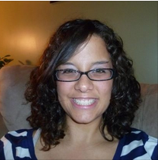
The Team
Students
Librarians
GenEd Faculty
Notes:
Many people were involved in the redesign because the tool(kit) was designed for multiple purposes:
To satisfy the information literacy objectives of Cluster One (a mandated area of reporting)
To provide any and all students with information about using library resources
To provide a place for librarians to place learning objects they created
Starting with GenEd, we were fortunate to have access to student critiques of Go for the Gold. And they were very honest. Very honest.
We also had a very close working relationship with GCOM, the course in which the information literacy objectives are embedded.
We had access to a talented web designer who was easy to work with and had the skills we needed.

Slide 4
Process
Conversations with library staff
Information literacy conversations with GenEd people
Mining student input
Committee work putting IL
competencies into plain language
Notes:
To meet the multiple needs we had multiple conversations
We had to translate the objectives into plain language and action
We were fortunate in that Melody came from outside of the library world, so she served an important role in helping us avoid jargon. If it didn’t make sense to her, it sure wouldn’t make sense to our students.

Slide 5
Technologies Used
Write script
Get pictures
Record videos (Camtasia)
Edit
Upload
Link in Canvas
Create quizzes
Notes:
Steps
Write script. Get input, make changes, get more input, make more changes
Begin powerpoint structure, find or take pictures
Record videos with powerpoint
Make edits, re-record, closed captions

Slide 6
Cluster One of GE is time-bound. Students must complete it by the end of their first academic year.
JMU’s GenEd program is outcomes-based. The GenEd Learning Outcomes are assessed by the Center for Assessment Studies (CARS). If we say we teach it, we have to assess it.
Notes:
Our GE program is comprised of 41 credit hours broken into “collections” of courses, called Clusters. Cluster one is foundational skills.

Slide 7
First Year Student Required Courses
Classes offered by five departments (History, Media Arts & Design, Business, History, Integrated Science & Technology, Philosophy
Class delivered by the Communication Studies faculty. (85F/75S)
Class delivered by Writing Department. 1/3 of JMU students do not take this class. (AP/IB credit)
Content delivered via Tutorial & Test Created by librarians

Slide 9
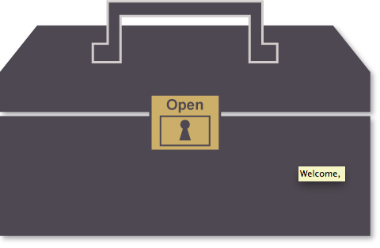
JMU’s C1 Information Literacy Learning Outcomes
Taught via Tutorial
Madison Research Essential Skills Toolkit
Practice Exercises embedded in GCOM courses (LMS)
Assessed via Test
Madison Research Essential Skills Test (MREST)
55 item multiple choice test
Proctored Lab
Competency Test
Deadline
BOTH DIRECTLY MAP TO THE LEARNING OUTCOMES

Slide 10
Learning Cycle Theory and Practice
Establish Objectives
Use Information
Select/Design Instrument
Collect Information
Analyze Information
Report Results
GE Learning Outcomes/Tutorial
MREST
Students Complete
Data & Scores Analyzed
Tutorial Modified
Cluster Report
Notes:
Introduce learning cycle and then explain this is the learning cycle in practice with our first year students for Info Lit competencies development. Introduce test data analysis.

Slide 12
C1/IL Objective 3: Evaluate the Quality of Information – Teaching Space..
Let’s Review the Tutorial
Let’s Take the Practice Exercises

Slide 13
C1/IL Objective 3: Evaluate the Quality of Information – AssessmenT/MADISON RESEARCH ESSENTIAL SKILLS TEST (MREST)
ITEM ID# 221 objective: 3 answer 4
When should you evaluate a source by publication date?
(a) only when you are working on scientific topics
(b) when the resource is 20 years old or older
(c) if the author has recently died
(d) when the topic requires the most current information
ITEM ID# 12304 objective: 3 answer 3
Jason is working on an assignment for GBUS. He has to follow the stock in XYZ Company in order to determine if the stock is one he should recommend for purchase. Which source of information would best help him make that recommendation?
(a) The XYZ Company's website
(b) A blog posting from someone who owns the stock who has lost money
(c) A chart from an independent source on the stock's performance
(d) A recommendation from a broker's website noting clients who have made money

Slide 14
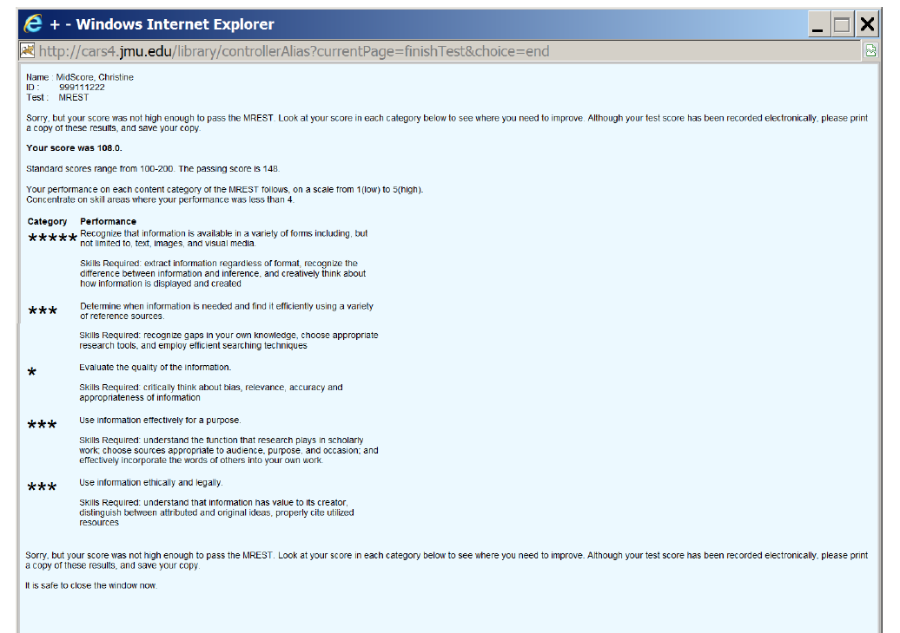

Slide 15
C1/IL Objective 3: Evaluate the Quality of Information – MREST Score data MREST
All 1st time test takers
Objective | Items | Mean % correct
Evaluate the quality of information | 11 | 68%
All Examinees who passed on the first attempt
Objective | Items | Mean % correct
Evaluate the quality of information | 11 | 73%
All Examinees who did not pass on the first attempt
Objective | Items | Mean % correct
Evaluate the quality of information | 11 | 61%

Slide 16
Learning Cycle Theory and Practice
Establish Objectives
Use Information
Select/Design Instrument
Collect Information
Analyze Information
Report Results
GE Learning Outcomes
MREST
Students Complete
Data & Scores Analyzed
Tutorial Modified
Cluster Report
Notes:
Introduce learning cycle and then explain this is the learning cycle in practice with our first year students for Info Lit competencies development. Introduce test data analysis.

Slide 17
Using Test Data to inform Tutorial Content
ITEM ID# 1037 objective: 3 answer 2
Which of the following statements is NOT true about the concept of scholarly peer review?
(a) Peer review helps to ensure high quality of information
(b) Peer review is used in most news magazines
(c) Peer review means that work has been evaluated before publication
(d) Peer review is used in most scholarly journals
64% of students who fail on their first MREST get this wrong. The choose A (20%) or C (11%).
ITEM ID# 12305 objective: 3 answer 3
A friend has sent you a link to a YouTube video that is soliciting funds to assist children who have been kidnapped and forced into lives as child soldiers. You should:
(a) Immediately donate money
(b) Send the link along to your friends
(c) Verify the claims in the video
(d) Use it in your paper on childhood slavery
Passers get this right 100% of the time, non-passers get it right 98%. It’s too easy.

Slide 18
Not all useful data is Quantative– Classroom Feedback from Live, Angry Students….
Revise tutorials to include an introduction..
Because the next thing we need you to be able to do is evaluate the quality of information. This might be best explained by example. Let’s say, you are doing research on the value of a college education and you want to say that college graduates make more money over the course of their working lives than people who didn’t attend college. Which source might be better? A website from a bank that writes student loans or a research study done by an economist with years of income data? New scholars need to be careful to think about who is making the claims and how the claim is supported by evidence or research.
Your sources need to represent credibility based on expertise, not ease of locate-ability.

