Slide 1

Inciting Action:
Assessment Reporting Strategies that Fuel Change & Improve Learning
Kathy Clarke
Gretchen Hazard
Virginia Assessment Group
November 16, 2017

Slide 2



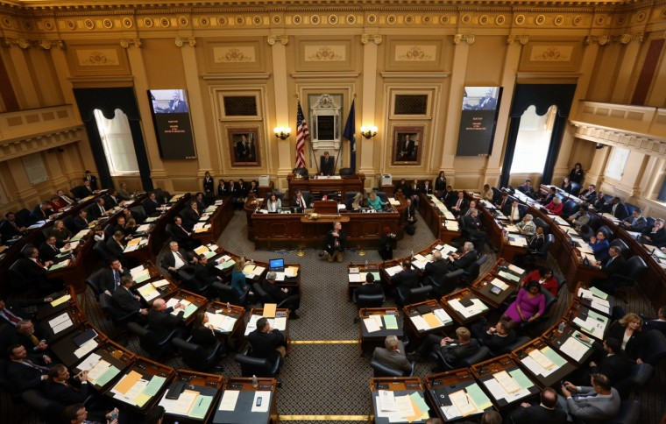






Notes:
Who do you report to? Where do reports go? Do they get used? What for?

Slide 3
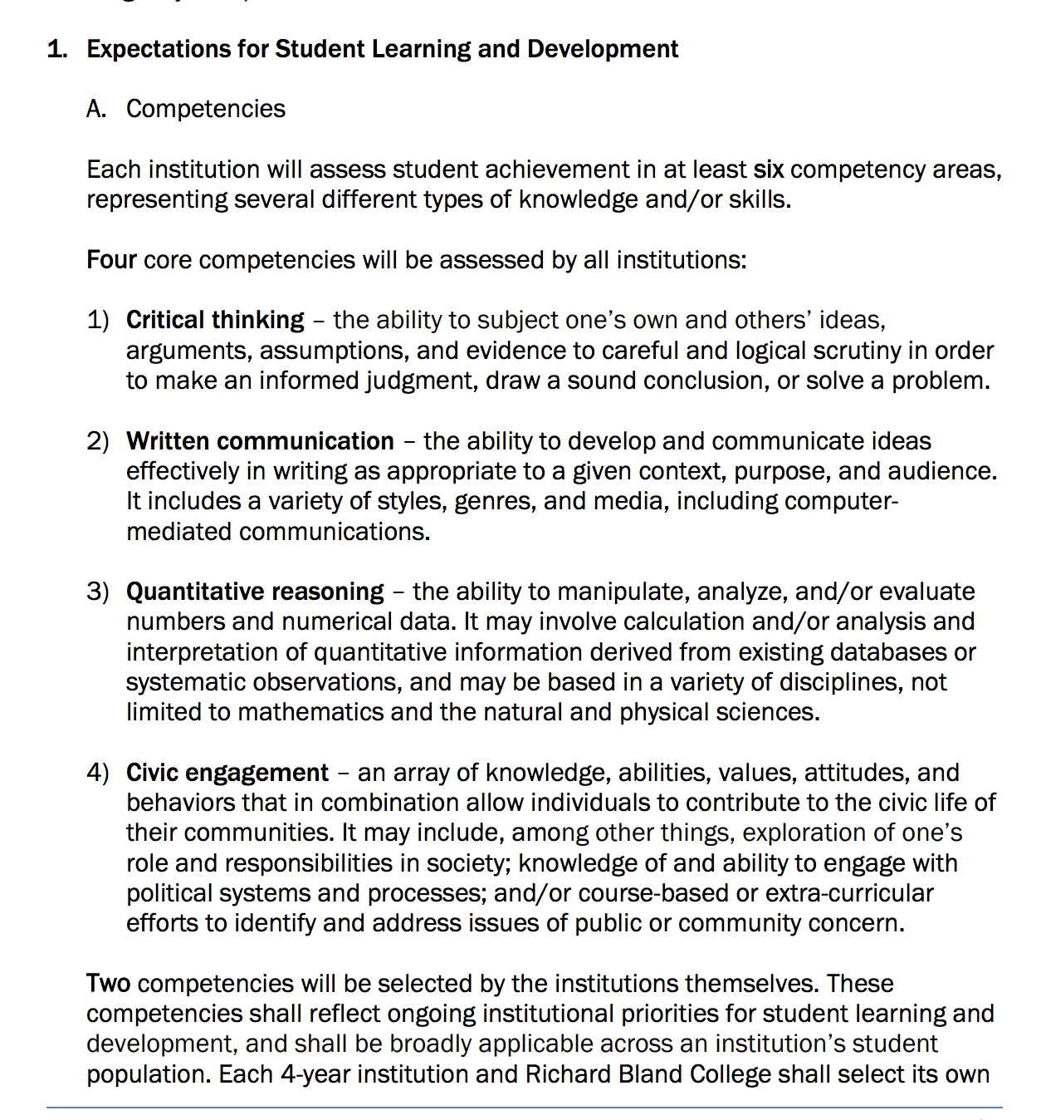

Slide 4


General Education
GE SLO
Learning Intervention
Instrument Selection
Gather Data
Report Results
Center for Assessment & Research Studies (CARS)
Notes:
Cluster Organization
GE Administration
Objectives-based structure
Faculty-designed
Reported internally and externally
Assessment Days

Slide 5
What do reports do?
Meet Requirements/Mandates
Validate Allocation of Resources
Justify Costs
Report on Change
Demonstrate Value
Report on Effectiveness
Identify Special Populations
Identify Gaps
Provide a Timely Snapshot
Permit Comparison
Provide Data

Slide 6
What do we WANT Reports to do?
Promote Student Learning Improvement
Facilitate Faculty Development
Increase Employability
Improve Retention
Question current allocation of resources
Establish Relevance
Promote Justifiable Action/Curricular Change
Tell a Sexy Story

Slide 7
What are our barriers to change?

Slide 8
Barriers
Dr. Macon M. Smarter
Dr. Quan T. Tative
Dr. Maya Opic
Able Learner
Dr. Pria Valed-Upon
President Sue Sinct
Dr. Ian Conclusive
Earnest Lee Tryin
Ms. Dottie d’Eyes & Mr. C. Ross Teaz
Mr. & Mrs. M. T. Nest
Provost G. Lori Daze

Slide 9
General Education
GE SLO
Learning Intervention
Instrument Selection
Gather Data
Report Results
Meaning Making
Center for Assessment & Research Studies (CARS)
Notes:
Cluster Organization
GE Administration
Objectives-based structure
Faculty-designed
Reported internally and externally
Assessment Days

Slide 10
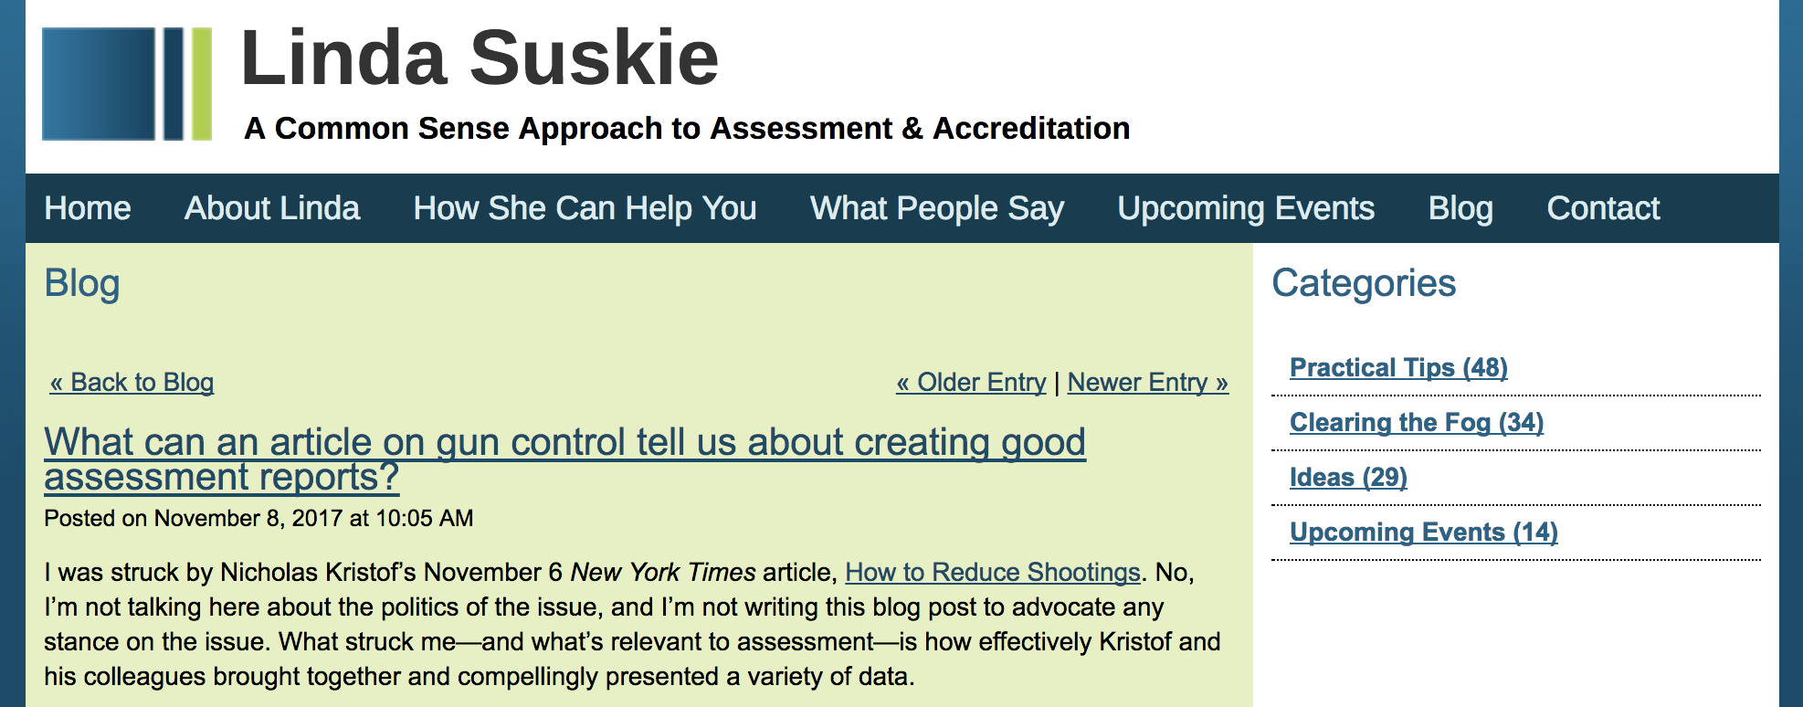

Slide 11



Focus on using the results rather than sharing the results, starting with the report title

Slide 12
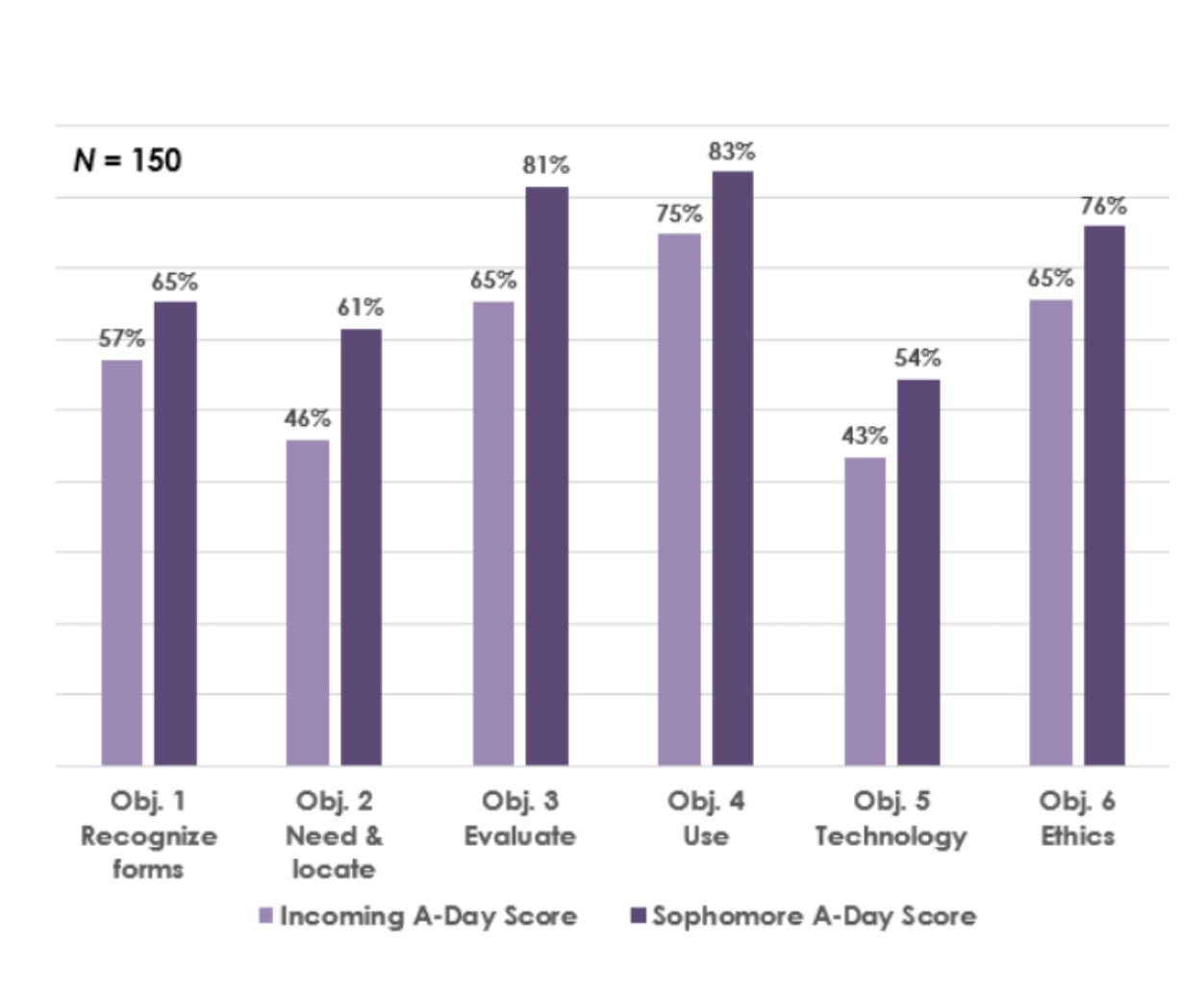
Focus on what you’ve learned from your assessments rather than the assessments themselves.
Information Literacy Pre & Post Test Scores

Slide 13
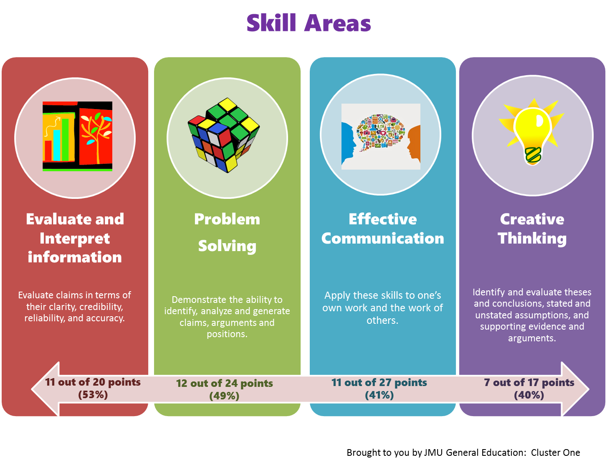
Go heavy on visuals, light on text.

Slide 14


Go heavy on visuals, light on text.

Slide 15
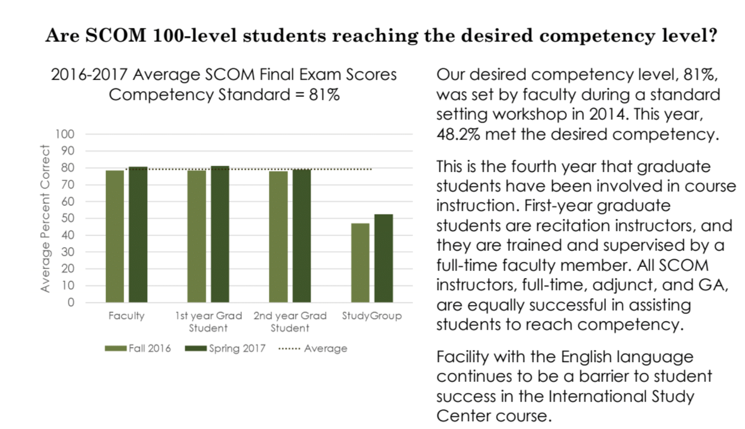
Go for graphs and other visuals rather than tables of data.

Slide 16
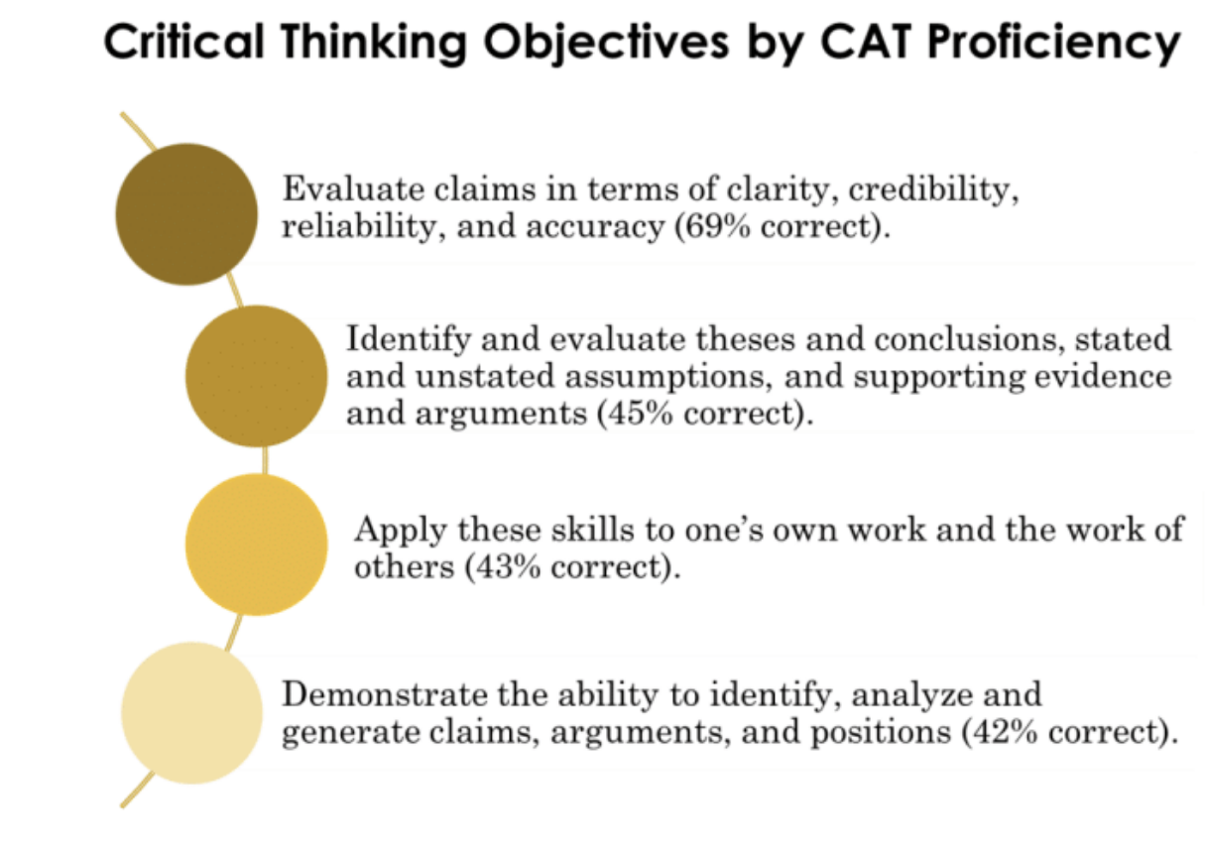
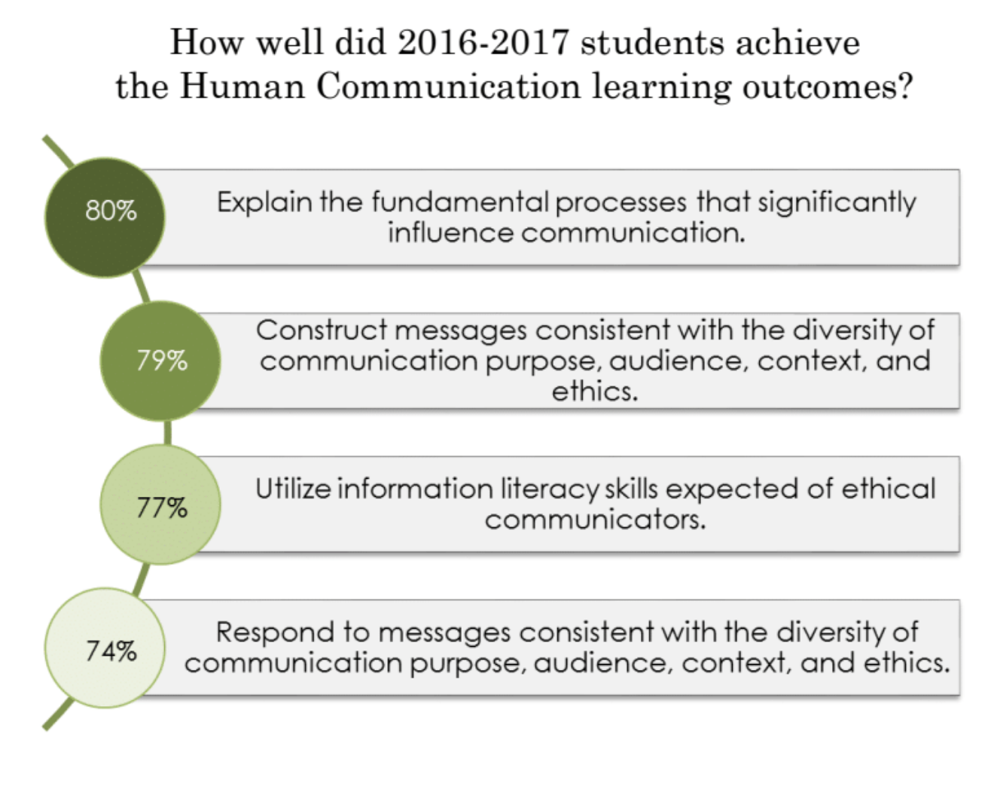
Order results from highest to lowest.

Slide 17
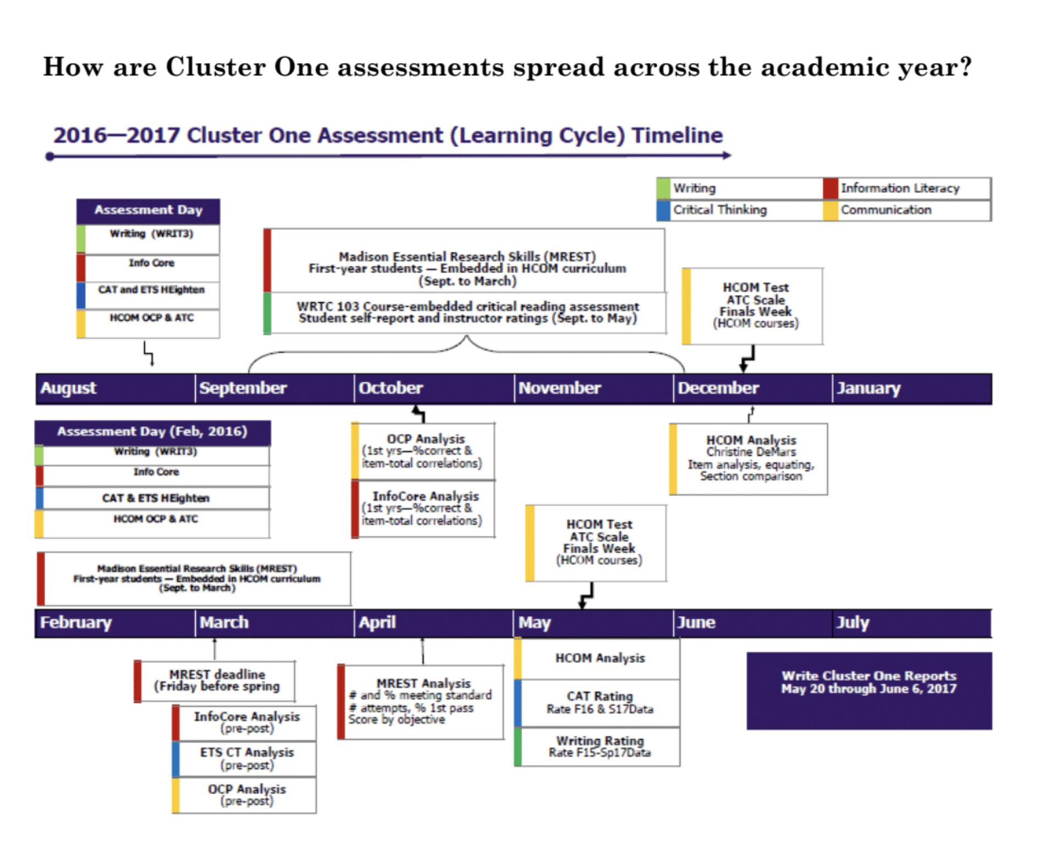
Use color to help drive home key points.

Slide 18
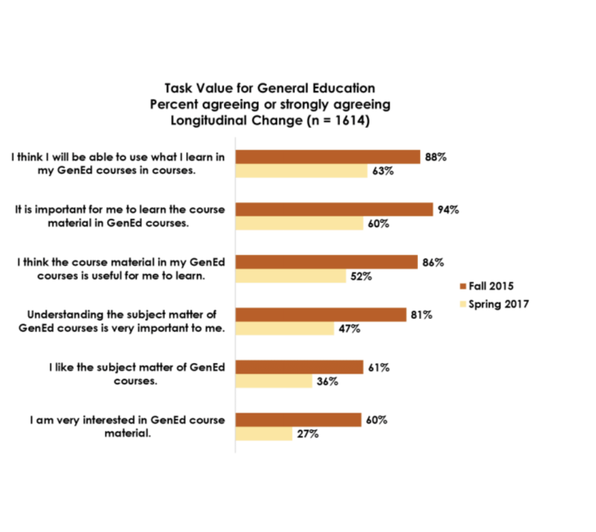
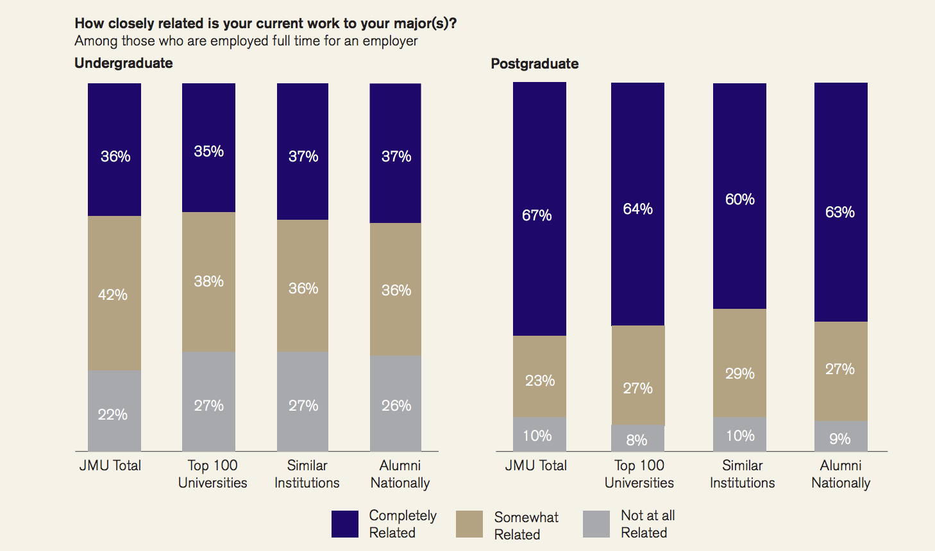
Pull together disparate data on student learning.

Slide 19
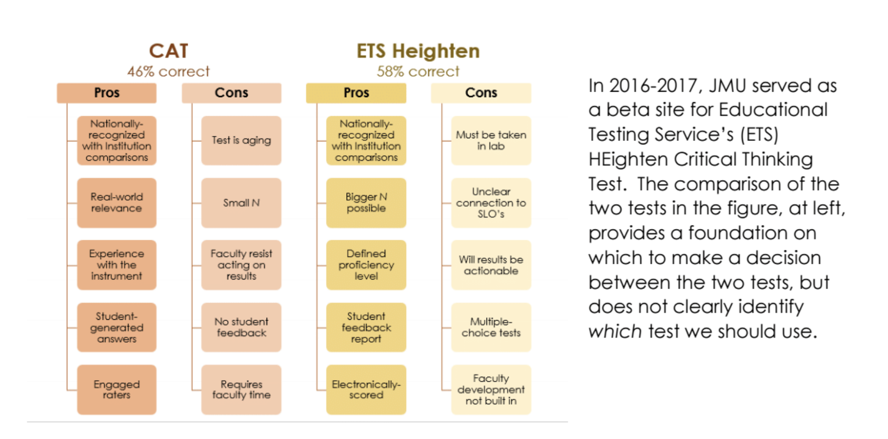
Breakouts can add insight, if used judiciously.

Slide 20
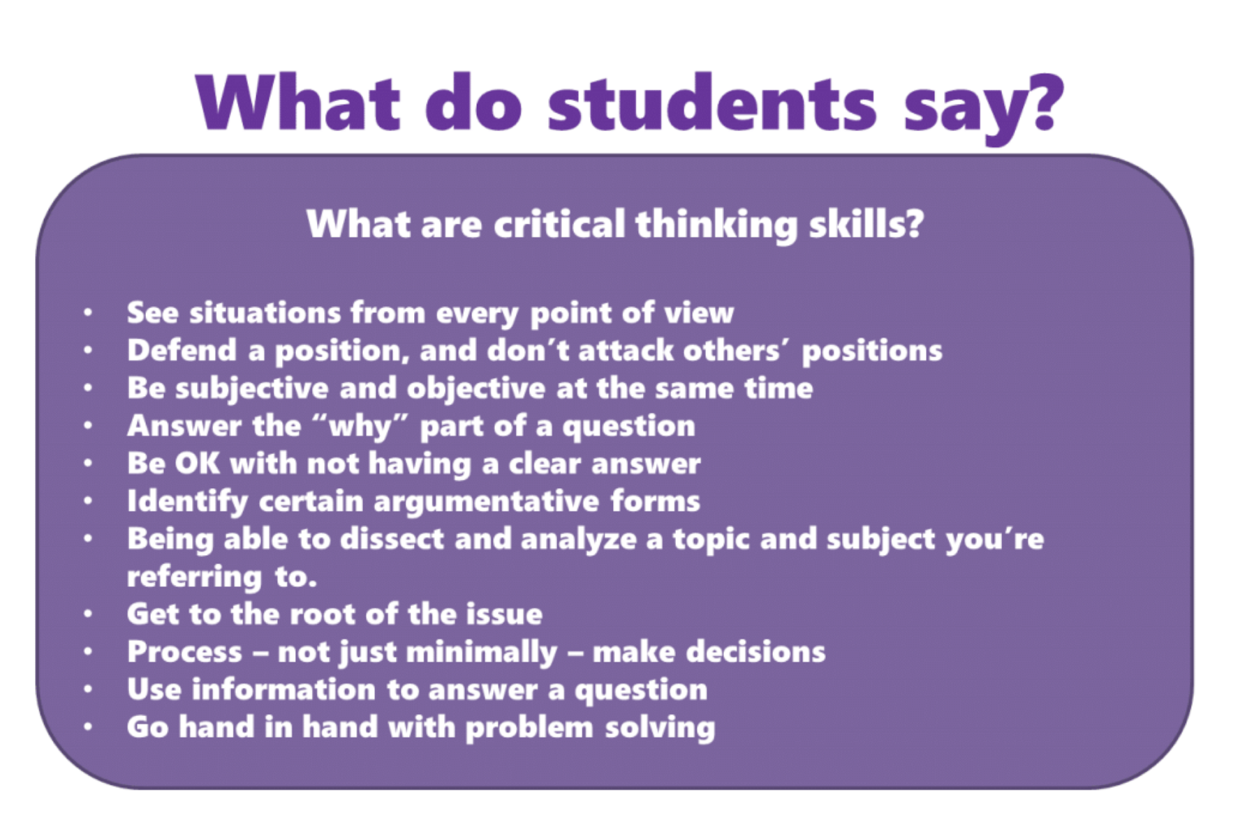
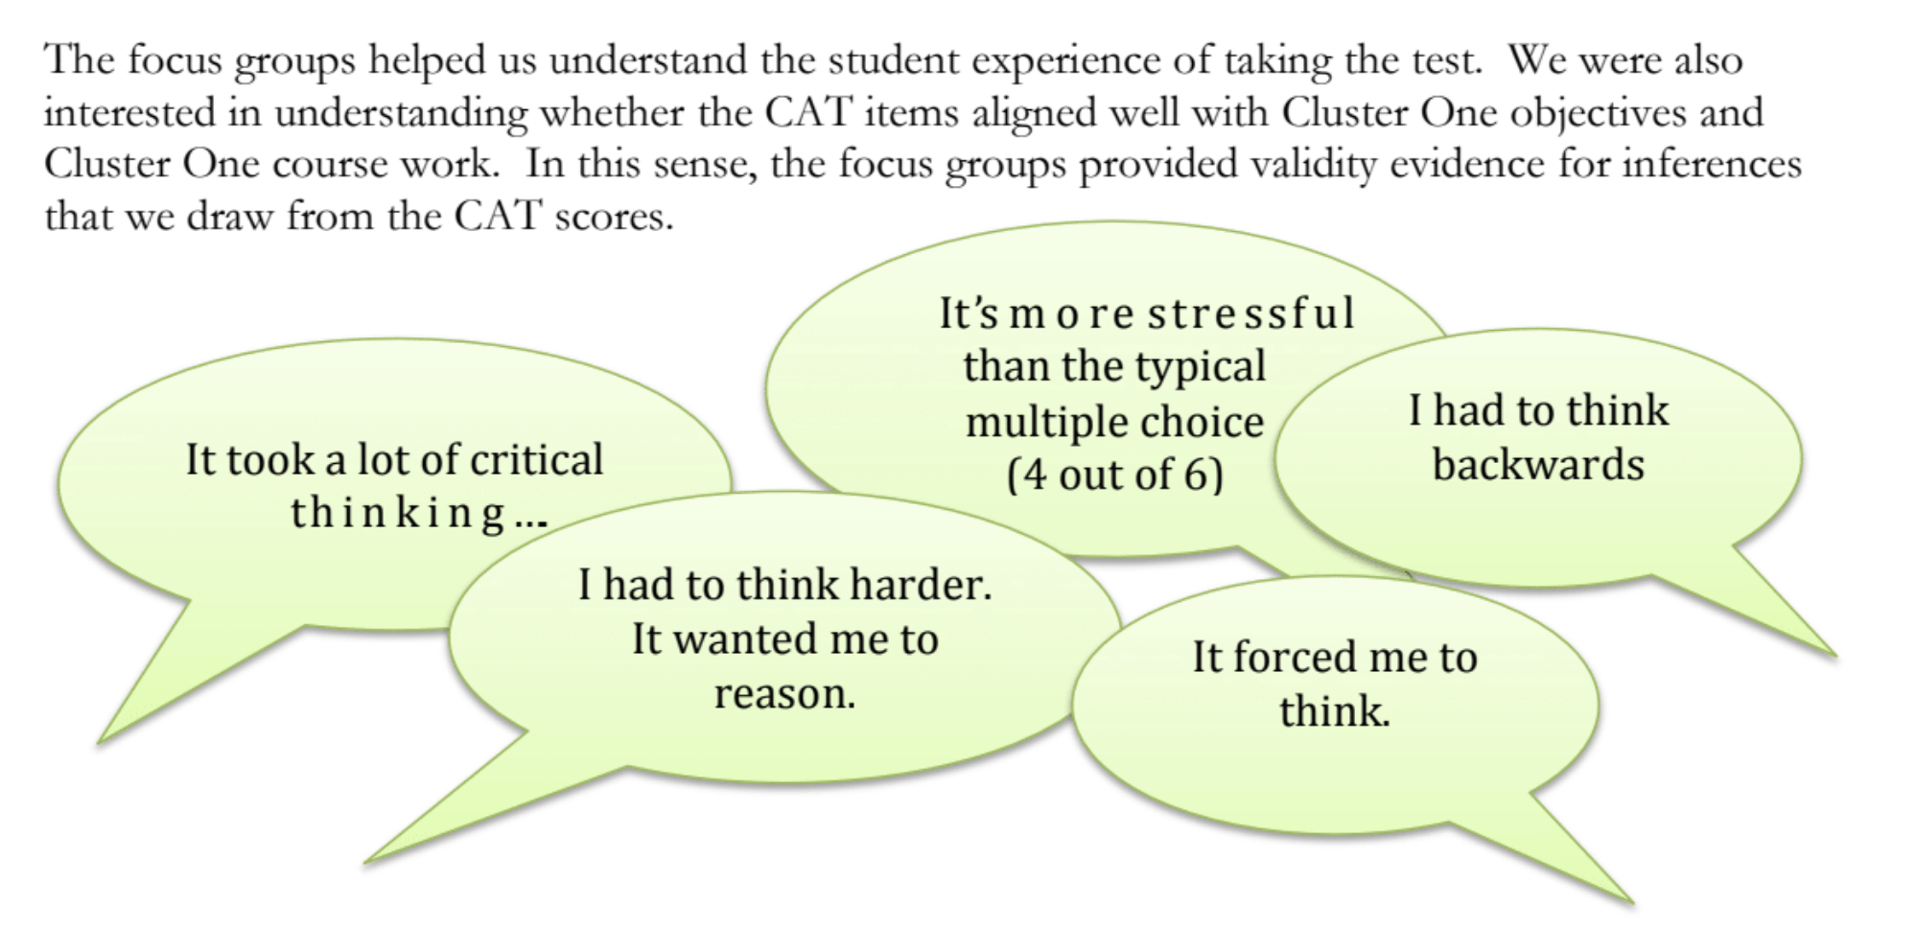
Get students involved.
Notes:
From 2014-5 CT Report

Slide 21
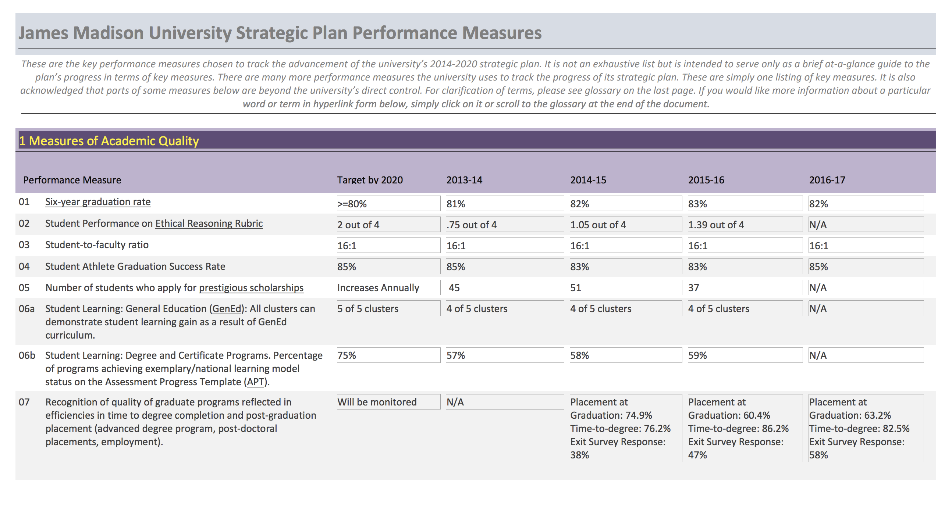
Distinguish between annual updates and periodic mega-reviews.

Slide 22
Reports

Slide 23
Engage the reader
Reach multiple audiences
Inspire action

