Slide 1
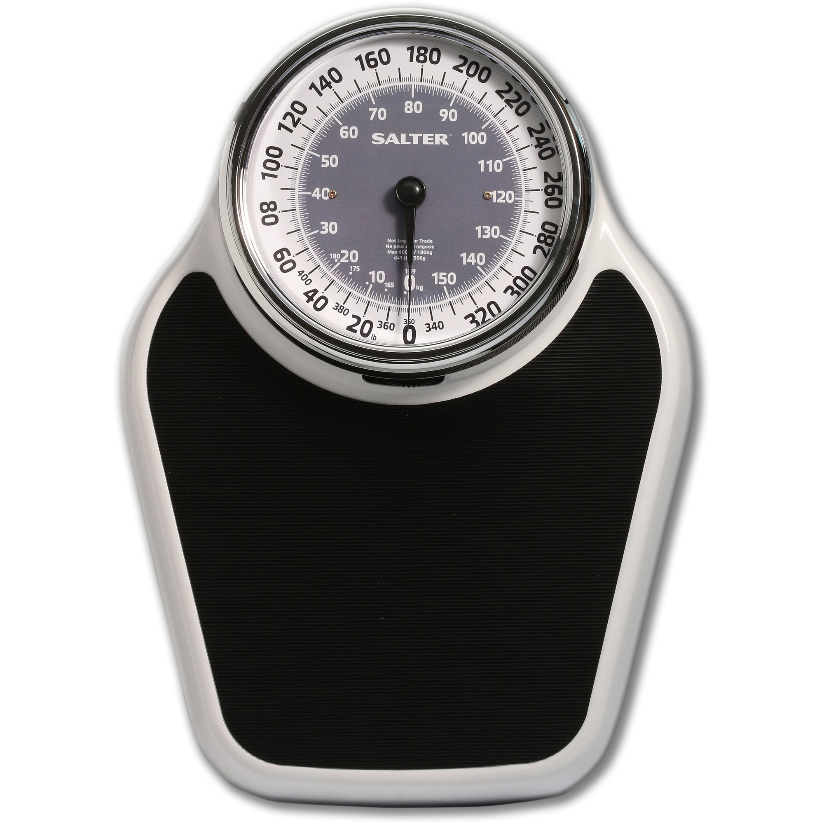
Should We Think About the Scale When We Weigh the Pig?
Gretchen Hazard
Kathy Clarke
S. Jeanne Horst
James Madison University
IU/PUI Assessment Institute
October 24, 2017

Slide 3
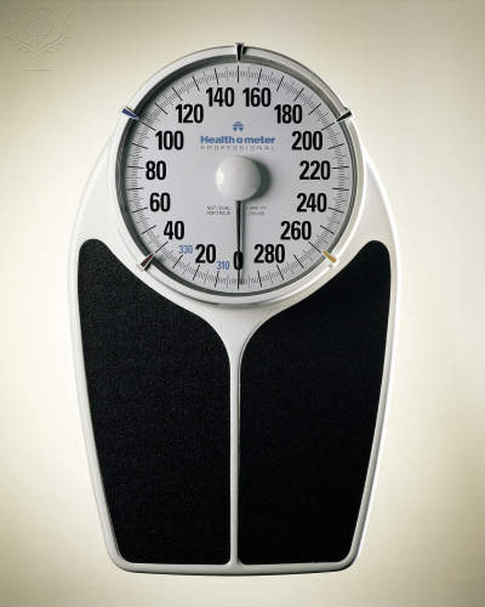
Objective: Make little pig bigger
This measurement helps.
Notes:
Classis pre/post model. Weigh little pig/ discern what you want or need to have happen or be learned/intervene somehow to make it measure, weigh again. Brag about your results to all who will listen.

Slide 5
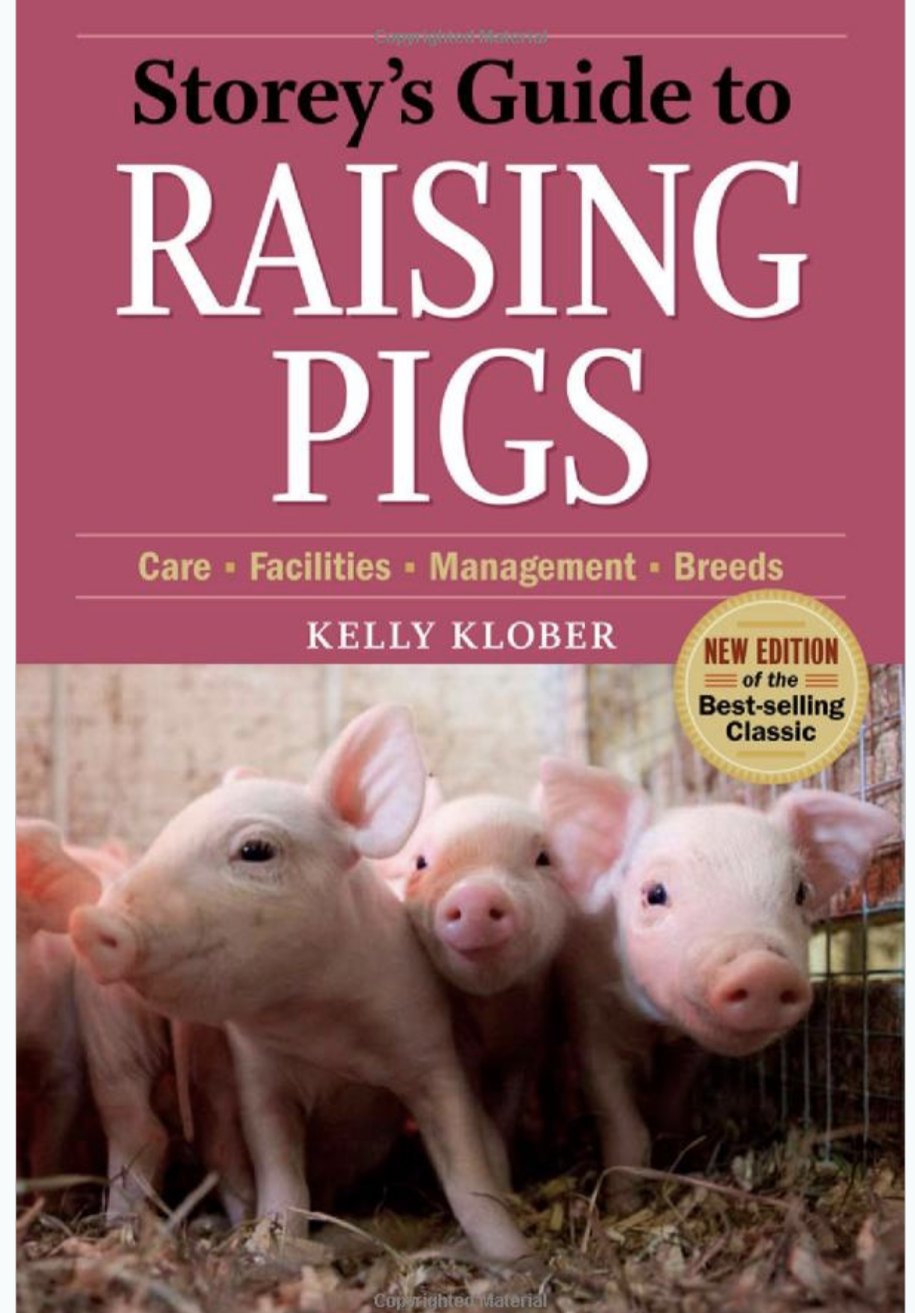
Objective: Cultivate a healthy pig lifestyle such that little pig grows
Will this tell me if Pig is healthy? No, it will not.

Slide 6
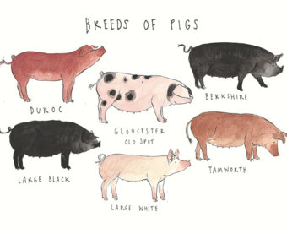
Looking for Difference
Notes:
When we are looking for Difference we need more than a scale. - do different breeds gain weight differently? Need more than a scale to find out.

Slide 7
Looking for Competence
Set a standard
Meet the standard
Notes:
Scale is part, it the standardness every market pig meets

Slide 8
Looking at the relationship between weather and pig weight
Notes:
Is there a relationship between the kind of weather a pig is raised in that makes them weigh more? Does the weather impact pig growth?

Slide 9
We assess to find out one of these things….
Competency – can students meet a set standard?
Change over time – do students improve from first year to senior year?
Relationship – do students who take X intervention improve?
Difference – are students different according to some variable?

Slide 10
The Plan
Unpack the implications of their own choice of assessment instruments
Review reports of assessment activities for what is discernable and what might be lacking
Talk through how a particular instrument is chosen (or not).

Slide 11
Objectives
Learning Intervention
Instrument Selection
Gather Data
Make Meaning
Report Results
Learning Cycle

Slide 12
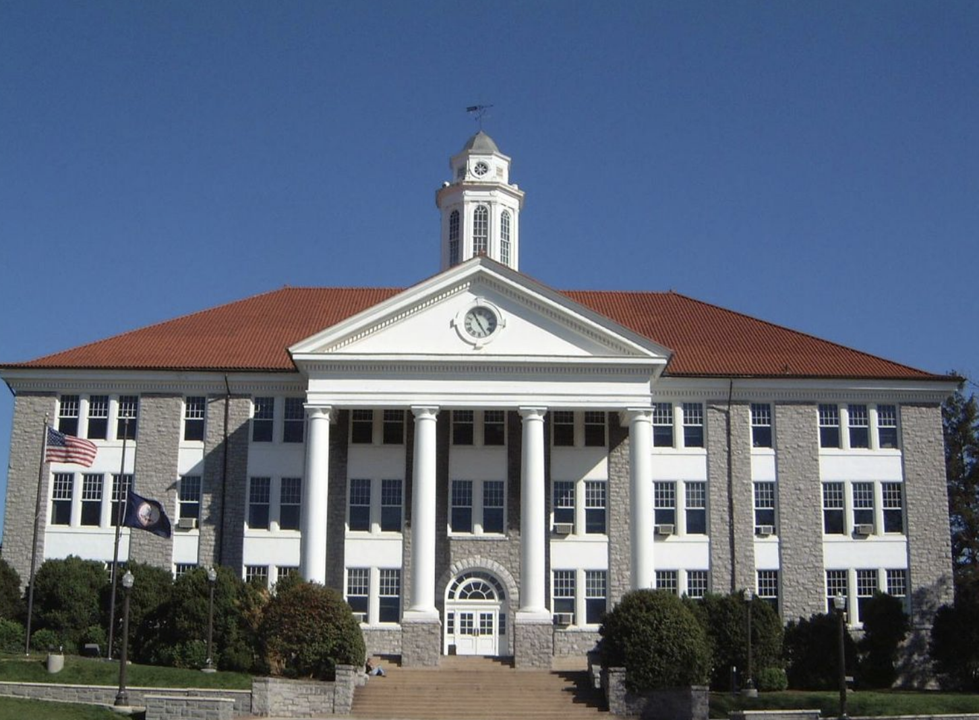
General Education
GE SLO
Learning Intervention
Instrument Selection
Gather Data
Report Results
Meaning Making
Center for Assessment & Research Studies (CARS)
Notes:
Cluster Organization
GE Administration
Objectives-based structure
Faculty-designed
Reported internally and externally
Assessment Days

Slide 13
JMU Information Literacy Learning Cycle
InfoLit Objectives
Essentials Toolkit
Competency Test
August-April
Meaning Making
Report Results

Slide 14
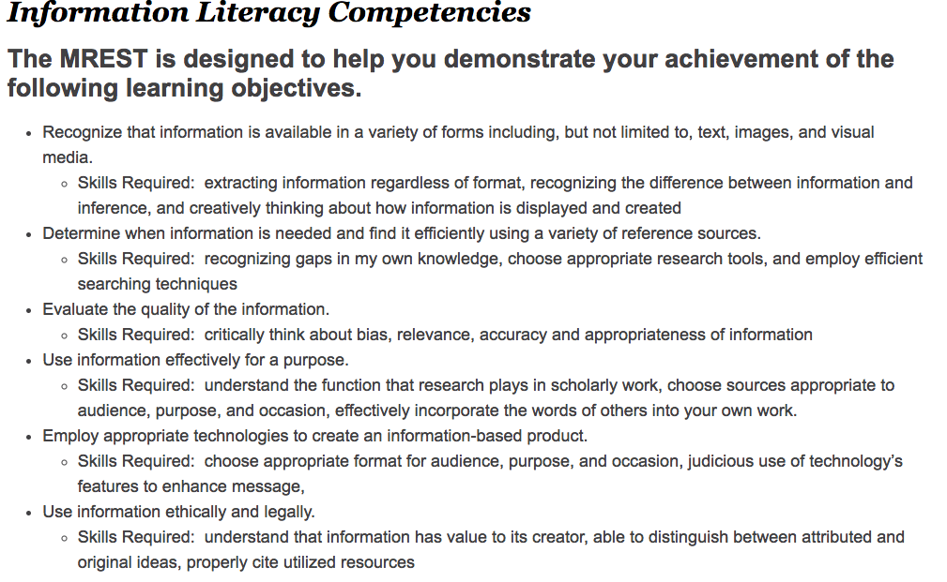

Slide 15
Foundational Skills @JMU
Notes:
This slide helps us talk about the uniqueness of the MREST

Slide 16
Notes:
We thought this was revolutionary in 2014. Subscales. We dutifully reported them as we saw them.

Slide 17
Notes:
We thought this was revolutionary in 2014. Subscales. We dutifully reported them as we saw them.

Slide 18
Competencies - MREST
Notes:
Then we got fancy with design layout which actually makes it easier to see where we should spend time on improvements to the intervention.

Slide 20
Change/Time vs. Competency
Notes:
Or deploy the instrument in a different way to find out a different kind of information. This is a pre/post test model of a sample of the same students from first year to second year A-Days.

Slide 21
Critical Thinking@JMU
Notes:
This slide helps us talk about the uniqueness of the MREST

Slide 23
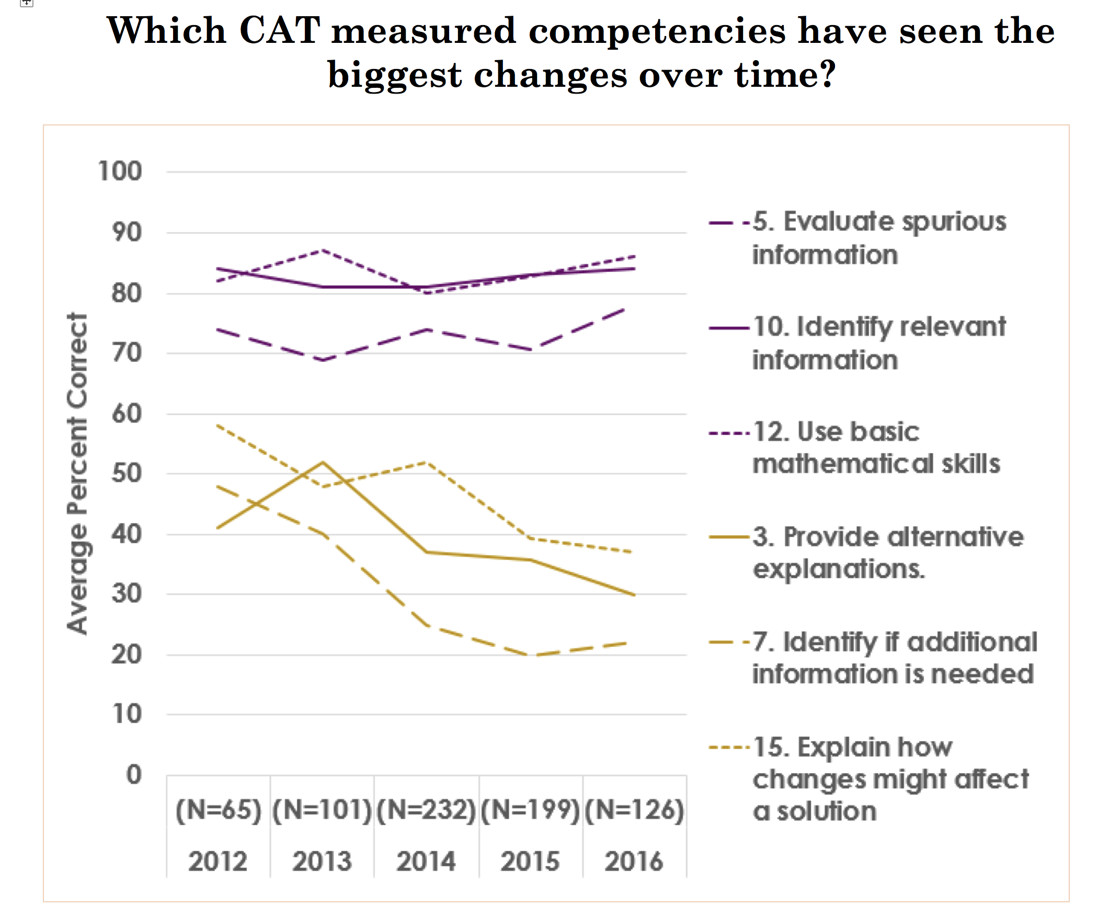

Slide 25
.

Slide 26
What instruments are you using?
What is your data telling you?
What do you wish you knew?

Slide 27
Same Instrument/Different Questions
Competency 200lbs=competent pig
Change over time=weigh/feed/weigh
Difference=pig breed A gains weight differently
Relationship=weather impacts pig size

Slide 28
Competency

Slide 29
Change Over Time

Slide 30
Difference
Notes:
If we measure by shape,

Slide 31
Relationship

