Slide 1
Developing Communication Plans to Support Technology Changes
Jody Condit Fagan
Malia Willey
LITA Forum
November 9, 2018
Notes:
Introduce presentation title and presenters
Jody Fagan is the Directory of Technology at James Madison University
Malia Willey is the Humanities Librarian at James Madison University

Slide 2
Goals
Present a model for a communication plan
Provide examples of communication plans for technology changes
Apply a model for a communication plan to scenarios
Notes:
Our goals for today are to:
Present a model for a communication plan
Provide examples of communication plans for technology changes
Apply a model for a communication plan to scenarios
During this presentation portion of our workshop, we will work through one model for developing a communication plan and provide interactive examples throughout
During the discussion portion at the end of the presentation, we will have worksheets to practice applying a communication model to an example scenario or for troubleshooting a scenario of your own

Slide 3
Project Management Context
Concepts
Leadership
Management
Buy-in
Communication
People
Project sponsor
Project manager
Project team
Stakeholders
Documents
Project overview
Task list
Timelines
Communication plan
Notes:
[Image of a vacuum in background]
Communication plans do not exist in a vacuum. There’s a whole context for project management surrounding communication plans.
Today we will be covering just “Communication” and the “Communication Plan” aspects of project management.
Communication involves gaining buy-in from stakeholders. We want stakeholders to agree with, or at least understand, the reason for the change that’s happening.
Communication plans specifically help anticipate stakeholder responses through intentional planning
They also have the additional benefit of creating a record for future referral
Communication and communication planning are especially important when it comes to technology because technology changes can often impact the experiences of our stakeholders

Slide 4
Communication Plan Model
Describe
Describe the scenario in need of a communication plan
Identify
Identify stakeholders and perspectives
Design
Design appropriate communication actions
Create
Create a communication timeline
Notes:
The model for a communication plan that we will be using today involves four steps:
Describe the scenario in need of a communication plan
Identify a stakeholders and perspectives
Design appropriate communication actions
Create a communication timeline
We’ll now unpack what each of these steps mean using an example
You can follow along with the example on the “Communication Plan Example: Self-Checkout" handout

Slide 5
Describe The Scenario in Need of a Communication Plan
What is the context in which the change is taking place?
Notes:
The example we will be using to illustrate a communication plan involves implementing a self-checkout kiosk
From a technical perspective, implementing self-checkout kiosk is just that: Installing self-checkout equipment and hooking it up to the library catalog.
But there’s more to the story…. What is the context in which the change is taking place? This context will help determine what needs to be communicated when and how
The context of our example involves giving library users at an academic library another option and location for checking out in addition to the circulation desk.
The self-checkout kiosks will be located by the circulation desk and at another entrance that is away from the circulation desk. The introduction of the kiosks allows users to check out on their own and at an additional entrance.
If our context was something different, like introducing self-checkout kiosks to make circulation staffing easier at a public library, our communication plan might be different

Slide 6
Identify stakeholders and perspectives
"Include those you communicate/interact with now, as well as those you'd like to connect with."
(Creating a Proactive Communications Plan, 2017)
Notes:
Next, we will identify stakeholders and perspectives for the self-checkout scenario
A module on “Creating a Proactive Communication Plan” hosted Boston University suggests that you “include those you communicate/interact with now, as well as those you would like to connect with”
[Pair | Share] We’ve listed a few stakeholders for the self-checkout kiosk example on the handout. With those around you, take a moment to brainstorm additional stakeholders for this example. We’ll then share some of your ideas.
What stakeholders did you identify?
There are many types of stakeholders...
Internal stakeholders could include the project team, administration, or other library staff. This group could also include potential collaborators for the communication plan.
External stakeholders include, of course, various library users. This group can be very diverse. Library users may have different levels of experience with technology or different communication preferences.
Vendors and consultants might be contractual stakeholders that come from a business perspective
You may also find you have “phantom stakeholders” that you did not identify when you created your communication plan. But, when they do get on your radar, you can incorporate them into your plans!
For example, when we implemented self-checkout kiosks at JMU, some faculty expressed dismay that the kiosks lacked the human element of the circulation desk
As a liaison librarian, I adjusted my messaging about the kiosks to be about choice: There would continue to be staff at our Ask Desk, but some patrons might choose to use the kiosks for convenience.
I also explained that kiosks also afford library users more privacy if they wish to more discreetly check out materials.

Slide 7
Design Appropriate Communication Actions
Description
Goals
Perceptions
Key messages
Logistics
Notes:
Now that we have identified stakeholders, we will define the communication actions needed to communicate the change
For each communication action, we will consider the description, goals, perceptions, key messages, and logistics
The description is an overview of a communication action
The goals are what we hope to accomplish by the communication action
Perceptions are what we want our stakeholders to feel. It might not seem obvious to think about feelings when planning for technology changes, but feelings are an important part of communication
Key messages are what we are trying to communicate
And, lastly, the logistics are how we will implement the communication action
Depending on what you are planning, you may want to consult your library’s outreach or social media coordinators for help with their expertise

Slide 8
Communication Preferences
METHOD | STUDENT (%) | FACULTY (%) | STAFF (%)
Email | 81 | 95 | 91
Posters | 92 | 68 | 52
Libraries website | 66 | 83 | 64
Libraries newsletter | 58 | 65 | 46
Campus newsfeed | 47 | 61 | 77
Campus mail | 62 | 36 | 47
Table tents in library | 68 | 29 | 42
Campus calendar | 51 | 41 | 55
Facebook | 58 | 38 | 42
(Gustafson, Sharrow, & Short, 2007, p. 427)
Notes:
When considering logistics, you might want to think about how stakeholders may have different communication preferences
An article by Gustafson, Sharrow, and Short (2017) describes the findings of the communication preferences of students, faculty, and staff at the College of Wooster in Wooster, Ohio.
This study is particularly helpful because it illustrates how communication preferences vary by stakeholder
For example, they found faculty, staff, and students had a high preference for email communication
However, students seem to prefer posters a bit more than faculty and staff

Slide 9
#SELFcheckyoself #selfcheckselfie
Notes:
Next let’s apply a communication action to our self-checkout example. You can follow along on the handout if you want.
The description of our communication action involves engaging library users with the self-checkout kiosks though social media for the chance to win a prize.
This contest was inspired by a meme based on the popular television show Parks and Recreation. As you may know, Donna and Tom indulge in a materialistic day where they “Treat Yo Self.” Library users will be encouraged to treat themselves by checking out a book using the kiosk.
The goal is to generate awareness and social media buzz for the self-checkout kiosks
The intended perception would be using self-checkout is fun and easy
The key messages are that self-checkout is beneficial to you. It is a treat.
The logistics are that the contest will be promoted on the library’s website and social media. Library users will post their selfies with the self-checkout kiosks to Twitter or Instagram using the hashtags #selfcheckyoself and #selfcheckselfie.
These are just generic hashtags ideas. You could, of course, customize the hashtag to your institution. For example, we could use #jmuselfcheckyoself or #jmuselfcheckselfie.
Then the five library users with the most inspired posts will each be treated to a $10 gift card from Starbucks. The kiosks will be further promoted by posting the winners on the library’s website and social media.

Slide 10
Design an Appropriate Communication Action for a Library Advisory Board
Description
Goals
Perceptions
Key messages
Logistics
Notes:
[Pair | Share] Now it is your turn to try drafting a communication action. What type of communication action might you design for a different audience, such as a library advisory board? Take a moment to brainstorm the description, goals, perceptions, key messages, and logistics with those around you.
What are some ideas you discussed? How were your ideas different from the social media campaign?

Slide 11
Create a Communication Timeline
In what order should the communication actions take place?
Notes:
Once the communication actions have been designed, we then need to think about what order they should take place
Some stakeholders might require sooner communication than others

Slide 12
Which communication actions should happen sooner? Later?
Social media contest for library users
Introduction to Friends of the Library group
Overview with library staff
Article in library newsletter
Distribution of bookmarks and table tents
Publish “about self-checkout” web site
Notes:
Audience Activity:
Here are some examples of communication actions for our self-checkout example.
Take a moment to read them, then I’m going to ask you which communication actions you think would need to happen sooner and what actions could happen later.
[wait a bit]
Which communication actions do you think might need to happen earlier? And later?
[Mention internal stakeholders might come first, if that doesn’t come up]

Slide 13
All Together Now
Describe a scenario in need of a communication plan
Identify stakeholders and perspectives
Design appropriate communication actions
Create a communication timeline
Notes:
So, we have described the scenario, brainstormed stakeholders, designed some actions, and put together a timeline.
You can generate communication plans like this on your own at your desk, or with a small group.
The end result might just be a two-page document, like the Self-Checkout Example Handout, or if you’ve drafted a lot of text in advance, it might be quite long
What’s important is that your organization can now be on the same page, and it’s much less likely you’ll forget something important.

Slide 14
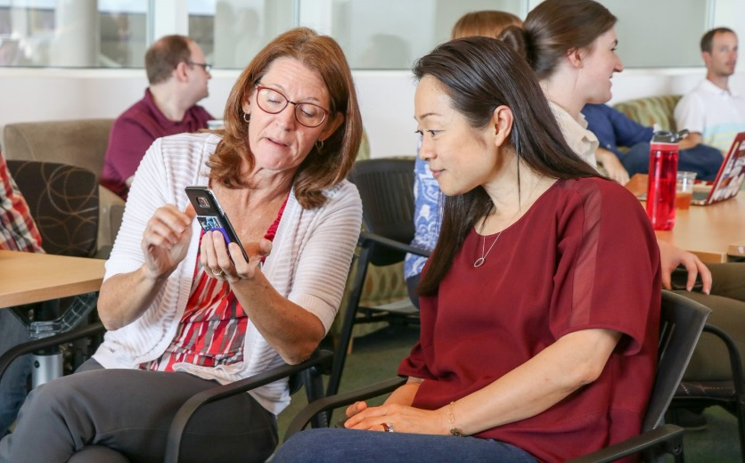
Putting the Plan into Action
Generate plan
Get others to review initial plan
Remind frontline staff
Notes:
However you’ve begun, it’s critical to review your ideas with someone not directly related with the project. This could be a colleague not involved in this project, someone at another library, or even a friend or partner.
You also might want to review the plan with your top leader or leadership group. At JMU Libraries, our faculty will email the dean and associate deans directly about technology changes they don’t like, so we usually include our them.
As the plan moves forward, remind internal stakeholders just before each communication action.
Your front line service desk staff might start getting a bunch of phone calls about the selfie campaign
Your IT support people might get technical questions about the self-checkout kiosk
If you have a central IT department (not part of the library) some projects might generate calls to their support center
Faculty might ask subject librarians questions
You also have the opportunity to revise the plan as you go – it’s not set in stone!

Slide 15
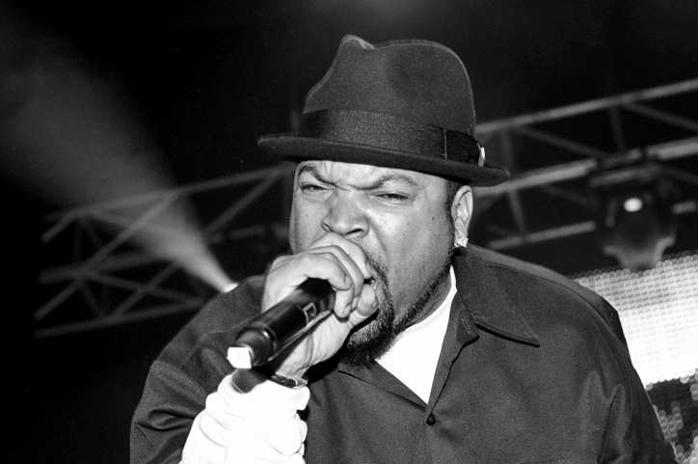
Revise the Plan as You Go
"Check yo self before you wreck yo self"
(Ice Cube, 1992)
Notes:
For example maybe you discover the #checkyoself hashtag is swamped with references to Ice Cube’s famous song, so in future communications you just use #selfcheckselfie. But maybe the kiosk actually got more visibility because it was temporarily linked to another campaign in a humorous way!
You also might get an idea of whether the messages you’ve devised are having the effects you envisioned. Maybe the “privacy” aspect of self-checkout doesn’t seem to resonate with anyone, but they mention how convenient the location of the kiosk is. Revise future communication messages accordingly.

Slide 16
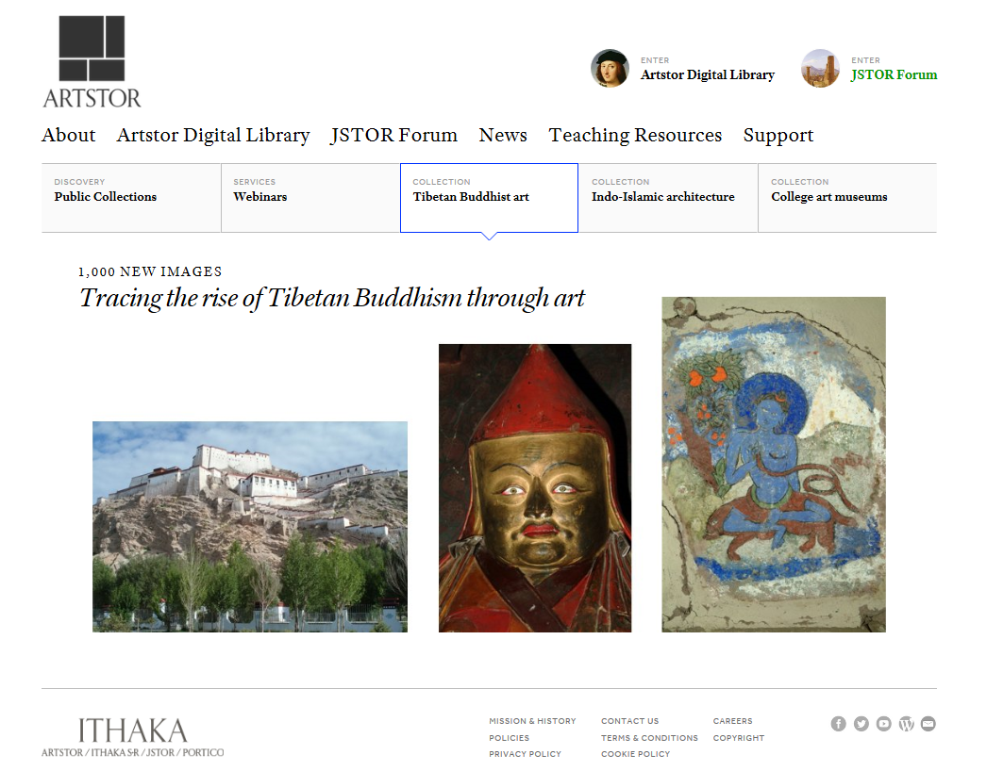
Best practice example: Artstor and JSTOR Forum
Notes:
Now we’d like to offer some best practices based on a communication plan Malia and I used in real life this past year. You can follow along using the “Artstor-JSTOR Forum Communication Plan Handout” if you want, or just refer to that later.
The scenario was that the library had subscribed to some new image repository and presentation software (Artstor and JSTOR Forum) to help faculty create classroom presentations – art history especially. The larger context was that art history faculty really liked the old software (MDID) and in fact, had helped create the old software, so they felt a personal connection to it.

Slide 17
Artstor and JSTOR Forum: email to art faculty
Goals
Perceptions
Reassure faculty the “old” software is still fully supported
Provide information about workshops
Ensure faculty know what communication channels to use
The libraries have heard your concerns about the “old” software going away
The libraries are supportive partners
The libraries are always willing to hear from you!
Notes:
One of our communication actions was an email communication targeted just to the art history faculty. We had met with them face to face once, and so this email was following up on action items. We wanted to reassure them the old software would still be fully supported, to provide information about workshops and ensure they would know what communication channels to use.
I want to highlight how the perceptions are similar, but written from a different angle. This is how we want faculty to feel after reading our email:
They have been heard
The library is supportive and we want to be partners
We want to hear from you

Slide 18
Artstor and JSTOR Forum: example email
Email Subject: MDID, Artstor, JSTOR Forum
Dear faculty,
Over the summer, the Libraries are ensuring MDID and the Desktop Media Viewer are fully updated and ready to go for Fall.
We are pleased to offer an Art History-specific demonstration and hands-on workshop in Artstor / JSTOR Forum on August 23rd, 4-6pm, in the Carrier TLT Lab. We can also do summer workshops in advance – if that includes you, please email David Gaines what dates/times would work for you.
Artstor also offers regular webinars and there will be an “Artstor A-Z Essentials” webinar on 6/13/18 if anyone wants to register for that on your own [link].
Please let us know if you have any questions or concerns, any time! We are here all summer.
Malia, Jody, David, David, Eric, and Mark
Notes:
So in the email, we started off by addressing with what we’d heard was their most important concern: that we would take away the old software they were used to: “The Libraries have ensured the software is fully updated.”
Then we described the workshop opportunities and asked them to let us know if they wanted additional workshops.
We included all the team members’ names because they had just met us all, but only hyperlinked the main contact.
This might seem pretty obvious, but without thinking through the perceptions, we honestly might have just focused on the logistics of the workshops and left it at that.

Slide 19
Artstor and jstor forum: Additional stakeholders and actions
Art History Faculty
“Personal touch”
Tailored workshops
Active Users of Old Software
Email about updates to old software
Workshops about migrating from old to new
Tailored emails
Faculty At-Large
General announcement about new software
Workshops showcasing new software
Notes:
In addition to our Art history faculty, we knew of about 30 random other faculty and staff who were current users of the old software.
Also we thought there might be a many other faculty and staff who might potentially use the new software
So we identified goals, perceptions, and key messages for the emails and workshops for these groups as well.

Slide 20
Artstor and JSTOR Forum: Timeline
Art History faculty and library
Art History faculty and faculty-at-large
Active users of old software & faculty-at-large
Notes:
Here is the communication timeline we used.
The top 6 rows of the timeline are Art History faculty and internal stakeholders, because we wanted them to have information in advance of more general announcements.
The second row mentions a web site – having this up early means emails can be shorter
The timeline helped us keep track of deadlines for things like the library newsletter
We reviewed a draft of this timeline with several groups: the library liaisons, so they could plan their own communications in concert with our mass emails; our director-level leadership, so they could identify if their area had more of an interest than we knew about; and our top leaders, because they’d been contacted by the department head with concerns prior to this plan being developed.
As we moved forward, the image migration happened much more slowly than anticipated, so we paused all JMU-wide communications so we would be able to talk about the success of migration with anyone who asked.
You can see an example of an additional communication action – the web site content - from this project in the Majic Communication Plan handout.

Slide 21
Wrap up / Discussion
Present a model for a communication plan
Provide examples of communication plans for technology changes
Apply a model for a communication plan to scenarios
Questions
Workshop a scenario
Feedback
Notes:
Here were goals we covered today!
If you want to join us for the Discussion period, we would be happy to take questions;
We also have a worksheet for if you want to practice applying this communication model

Slide 22
Contact Us
Jody Condit Fagan
Director of Technology
James Madison University Libraries
faganjc@jmu.edu
Malia Willey
Humanities Librarian
James Madison University Libraries
willeyme@jmu.edu

Slide 23
Works Cited
Creating a proactive communications plan [PDF document]. (2017). Retrieved from http://www.bu.edu/regionalization/files/2013/07/Creating-a-proactive-communications-plan.pdf
Gustafson, J. C., Sharrow, Z., & Short, G. (2017). Library Marketing on a small liberal arts campus: Assessing communication preferences. Journal of Library Administration, 57(4), 420-435.
Ice Cube. (1992). Check yo self. On The Predator. Priority Records.
Roeder, T. (2013). Managing project stakeholders: Building a foundation to achieve project goals. Hoboken, NJ: Wiley & Sons.

Slide 24
Works Consulted
Community Tool Box. (2018). Section 1. Developing a plan for communication. Retrieved from https://ctb.ku.edu/en/table-of-contents/participation/promoting-interest/communication-plan/main
Parks and recreation. (2009-2015). NBC Universal Television.

Slide 25
Image Credits
Slide 3: Photo by The Creative Exchange on Unsplash
Slide 5-7, 11, 13: Self checkout in library.jpg. By Steven Walling [CC BY-SA 3.0 (https://creativecommons.org/licenses/by-sa/3.0)], from Wikimedia Commons
Slide 14: Bobbi and Christie. Photo Credit: Debbie Pugh. JMU Libraries, 2018.
Slide 15: Ice_cube_c.jpg. By Stuart Sevastos (Ice Cube @ Metro City (29/10/2010)) [CC BY 2.0 (https://creativecommons.org/licenses/by/2.0)], via Wikimedia Commons
Slide 16: Screenshot of Artstor home page. © 2018 Artstor.

