Slide 1
From Tests to Rubrics: Strategies for Assessing Information Literacy at Three Institutions

Slide 2
Welcome!
Cynthia Kane
Instruction and Assessment Librarian, Emporia State University
Kathy Clarke
First-Year Librarian, James Madison University
Carolyn Caffrey Gardner
Interim Director of Assessment in Academic Affairs & Information Literacy Coordinator, California State University Dominguez Hills
Carolyn Radcliff
Information Literacy Librarian, Carrick Enterprises
Notes:
Introductions - in order of presentation
Plan for the session -
Set the stage for the panelists
Each will describe their situation in about 10 minutes
Activity for hands on
Questions at the end.

Slide 3
Information Literacy
Information literacy is the set of integrated abilities encompassing the reflective discovery of information, the understanding of how information is produced and valued, and the use of information in creating new knowledge and participating ethically in communities of learning.
Association of College and Research Libraries Information Literacy Framework for Higher Education 2015
Notes:
Information literacy is widely considered an important component of a college education and a growing body of research points to specific benefits of information literacy instruction.

Slide 4
Evidence for Benefits of Information Literacy Instruction
For students in their first year
For students in general education courses
Lasting improvement in academic performance for undergraduate students
Association of College and Research Libraries. Academic Library Impact on Student Learning and Success: Findings from Assessment in Action Team Projects. Prepared by Karen Brown with contributions by Kara J. Malenfant. Chicago: Association of College and Research Libraries, 2017
Notes:
Information literacy is widely considered an important component of a college education and a growing body of research points to specific benefits of information literacy instruction.
Students who receive information literacy instruction profit academically during their first year;
Information literacy instruction benefits students in general education courses
Evidence of lasting improvement in academic performance for those students who receive information literacy instruction
1 Association of College and Research Libraries. Academic Library Impact on Student Learning and Success: Findings from Assessment in Action Team Projects. Prepar

Slide 5
Measuring Information Literacy: Rubrics (Direct Assessments)
Strengths
Can be authentic
Can have strong alignment with your outcomes and goals
Clear direction for improvement
Challenges
Require time to create, refine, train, and use
Assume the product reveals the process
Sources
Locally-created
VALUE
Rubric Assessment of Information Literacy Skills (RAILS) http://railsontrack.info
Notes:
Limitations:
Require time to create, refine, and use
May have validity and reliability issues
Assume the product reveals the process
Strengths:
Can be authentic assessment
Can have strong alignment with your outcomes and goals
RAILS:
One of the most important attributes of rubrics is that they allow a variety of student work samples to be assessed uniformly, over time or across programs, and by multiple raters.

Slide 6
Measuring Information Literacy: Standardized Tests
Strengths
Usually easy to administer
Efficient method for large-scale assessment
Makes comparisons across time and groups easy
Suggest improvements
Challenges
May not align with your outcomes and goals
May be hard to motivate students
Assume students’ knowledge will affect their behavior
Cost
Sources
Locally-created
SAILS - Standardized Assessment of Information Literacy Skills
TATIL - Threshold Achievement Test for Information Literacy
Notes:
What's available
Limitations: May not align with your outcomes and goals May be hard to motivate students Assume students’ knowledge will affect their behavior
Strengths: Makes comparisons across time and groups easy Require less time from your faculty and staff than rubrics do

Slide 7
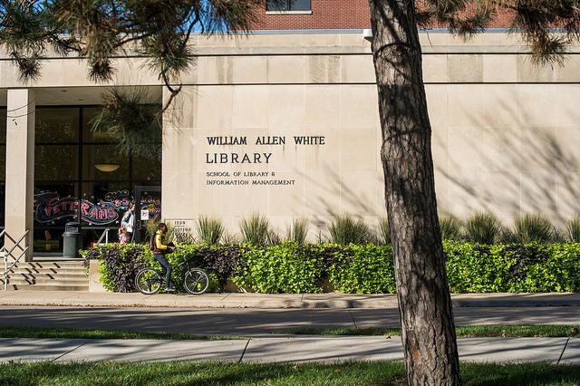
Emporia State University: From SAILS to TATIL
State-supported public university in SE Kansas
As of Fall 2017:
5732 students (headcount)
4804 students (FTE)
Programs:
College of Liberal Arts and Sciences
School of Business
The Teachers College
School of Library and Information Management (accredited by the American Library Association)
Notes:
Hello! I’m Cynthia Kane and I am the instruction and assessment librarian at Emporia State University in Kansas. A little background about our institution (refer to bullet points here)

Slide 8
Information Literacy at Emporia State University
Mainly accomplished by:
Tiered library instruction sessions in English Composition I and English Composition II
Individual library instruction sessions in discipline-specific undergraduate and graduate courses
UL100 - Research Skills, Information, and Technology (our focus for today’s presentation!)
Notes:
We have a relatively active instruction program at ESU, with librarians assigned to academic departments as liaisons. Like many universities, we approach information literacy through tiered instruction programs in English Composition as well as individual sessions in discipline-specific courses. A major focus for our library, though, is our credit-bearing course that all librarians teach and participate in.

Slide 9
UL100 and Its Place in ESU’s General Education Curriculum
Fall 2009: Emporia State updated its General Education curriculum for undergraduate students to include a goal of “Information Technology” (now “Information Literacy and Technology”.
UL100 is ONE of several courses that students can take to fulfill this requirement
Other courses that count include:
AR305, Introduction to Digital Design
IS110/113, Introduction to Microcomputer Applications w/lab
“An approved technology course in the discipline” - over 30 possibilities here
Fall 2018: UL100 is now a three-hour credit course (moved from two hours to compete with other offerings and to incorporate the ACRL Framework for Information Literacy for Higher Education)
Notes:
A little history about UL100 (refer to bullet points here)

Slide 10
Standardized Assessment from SAILS to TATIL
All UL100 sections utilize a standardized assessment of information literacy skills as a pre-test and a post-test at the start and the end of a semester.
Evolution:
2012-2013: ISkills -- Educational Testing Service (no longer available)
2013-2017: Project SAILS
2017-present: TATIL (Threshold Achievement Test of Information Literacy)
“Evaluating Process and Authority” and “Strategic Searching”
Notes:
All our UL100 sections share common student learning outcomes and most major assignments, such as an infographic and website creation. In addition, the librarians share rubrics for grading, although we adapt these rubrics accordingly as some of our assignments are modified for our specific sections. Early on, we wanted to explore some type of standardized information literacy assessments in order to benchmark where our UL100 students were starting with basic concepts of information literacy, and where we hoped they would be at the end of the semester! In Fall 2012, we started with iSkills from the Educational Testing Service. This test is no longer available, but it was a scenario-based problem-solving test that covered both information literacy -- mainly search statements in databases -- as well as problems involving spreadsheets and data sets. While the database portion was useful to us, we were not necessarily teaching or going toward learning outcomes for the rest of the iSkills questions. So, in Fall 2013 we switched to Project SAILS for UL100 pre-tests and post-tests. We liked the fact that SAILS was based upon the ACRL Information Literacy Standards for Higher Education, and that it focused upon many learning outcomes we were teaching such as access, retrieval, and evaluation of information sources. In 2016, we started utilizing the Build Your Own Test option of SAILS in order to customize test items that matched our assignments and outcomes most specifically.

Slide 11
Why Did We Switch from SAILS to TATIL?
Project SAILS was a great start for our information literacy assessments in UL100
Changed to the BYOT (Build Your Own Test) option in Fall 2016
Even with this change, we realized that some test items were not specifically aligned with our UL100 student learning outcomes
Alignment of student learning outcomes was increasingly linked to the ACRL Framework for Information Literacy for Higher Education reflected in the TATIL modules
Notes:
Project SAILS worked very well for our first forays into standardized information literacy assessments benchmarked against similar institutions. However, even changing to the Build Your Own Test option made us realize that we were still not capturing any additional measurements of student learning in areas such as creating learning objects -- in our case, student-created infographics and websites. Also, the adoption of the Association for College and Research Libraries Framework for Information Literacy for Higher Education as of January 2016 inspired us to rewrite our UL100 course description and outcomes to incorporate aspects of Scholarship as Conversation, Searching as Strategic Exploration, and Information Creation as a Process. As we did so, we were drawn to the work of Carrick Enterprises as they developed and beta-tested the modules of TATIL.

Slide 12
What Does TATIL Contribute to Our Course?
TATIL modules are crosswalked with the ACRL Framework. Specifically:
Evaluating Process and Authority:
“Information Creation as a Process” and “Authority is Constructed and Contextual”
Strategic Searching:
“Searching as Strategic Exploration”
https://thresholdachievement.com/the-test/about-the-test
Notes:
Specifically, this is how two of the four TATIL modules align with certain ACRL frameworks. These are the two modules we have chosen to focus upon in UL100 because they match very closely with the expectations for our undergraduate students, who are mostly freshmen and sophomores.

Slide 13
TATIL Experiences Thus Far
Spring 2017: TATIL pilot project with two UL100 sections taught by the same instructor (Strategic Searching module)
27 students took the module as both a pre-test and post-test
Fall 2017: TATIL launched with all UL100 sections (Evaluating Process and Authority, and Strategic Searching as pre-tests and post-tests)
Fall 2017: 94 students completed Evaluating Process and Authority as pre-test and post-test; 97 students completed Strategic Searching as pre-test and post-test
Spring 2018: 79 students completed Evaluating Process and Authority and Strategic Searching as pre-test and post-test
Fall 2018 (thus far): 89 students completed the Evaluating Process and Authority pre-test and 88 students completed the Strategic Searching pre-test
Notes:
(Go over bullet points here)

Slide 14
Future IL Assessments at Emporia State
NSSE (National Survey of Student Engagement) -- sent every other year to all ESU first-year undergraduate students and all seniors
Spring 2018: Topical module, Experiences with Information Literacy, was also part of NSSE:
http://nsse.indiana.edu/pdf/modules/2017/NSSE_2017_Experiences_with_Information_Literacy_Module.pdf
Continue with TATIL “Evaluating Process and Authority” and “Strategic Searching” with UL100 students
Potential University-wide discussion: Administering these TATIL modules as pre-tests and post-tests in other General Education courses?
Notes:
We continue each semester to review the results of the pre-tests and the post-tests and quite frankly, we are still identifying patterns in any changes with the outcomes, performance indicators, and dispositions in our students’ performance. We plan to continue with the aforementioned TATIL modules to establish some longitudinal data. In the meantime, we continue to work on raising awareness across campus of information literacy as both an General Education outcome and a discipline-specific outcome for all majors. (Refer to bullet points here for future goals, etc.)

Slide 15
Competency Model = Every Student/Every Year
Notes:
JMU comprehensive regional mainly undergraduate ~21000K undergraduate pop is 19K entering class =5000
Embedded in GenEd and in C1 of GE = time bound completed in the first year, talk about the other domains
Why embedded in SCOM

Slide 16
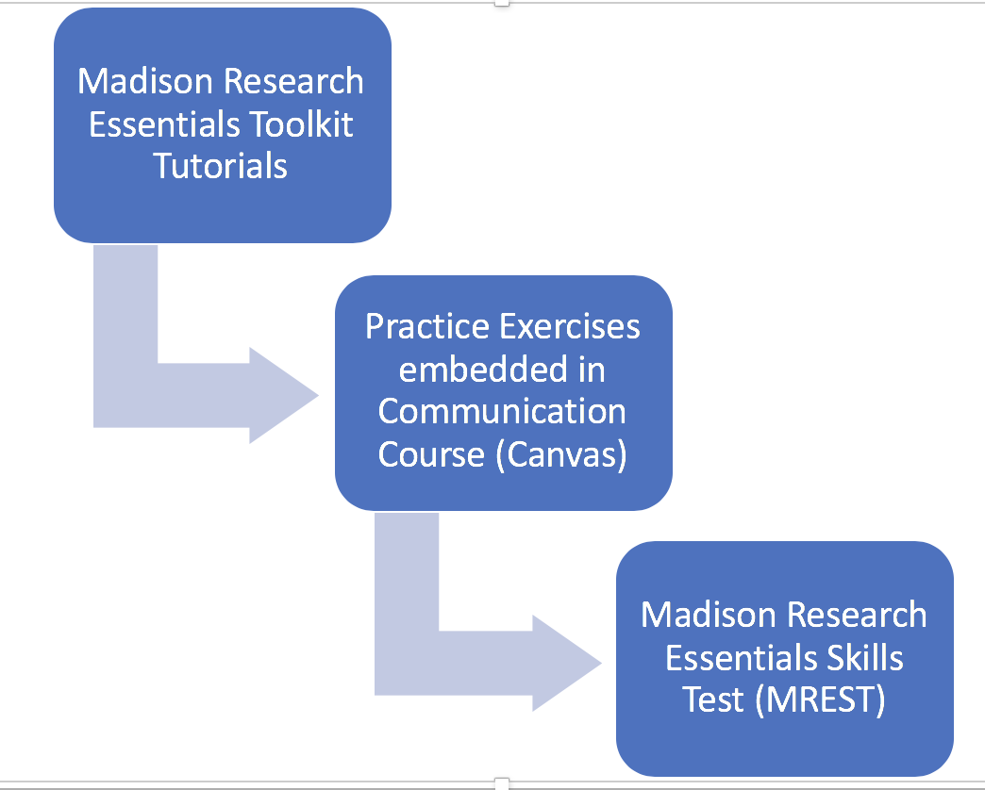
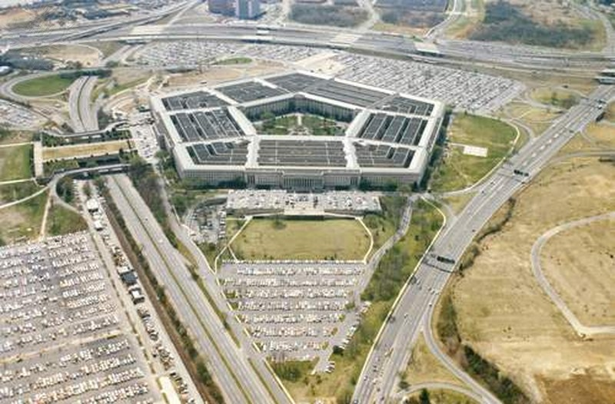
JMU’s Tutorial-Test Model for Information Literacy
Notes:
Use handout – see learning cycle and implementation. MREST home grown – because we have CARS and GE and relationship
Tight alignment between tutorial, practice and mrests – see handout for the examplse. Tutorial is conceptual, test questions are applications based.

Slide 17
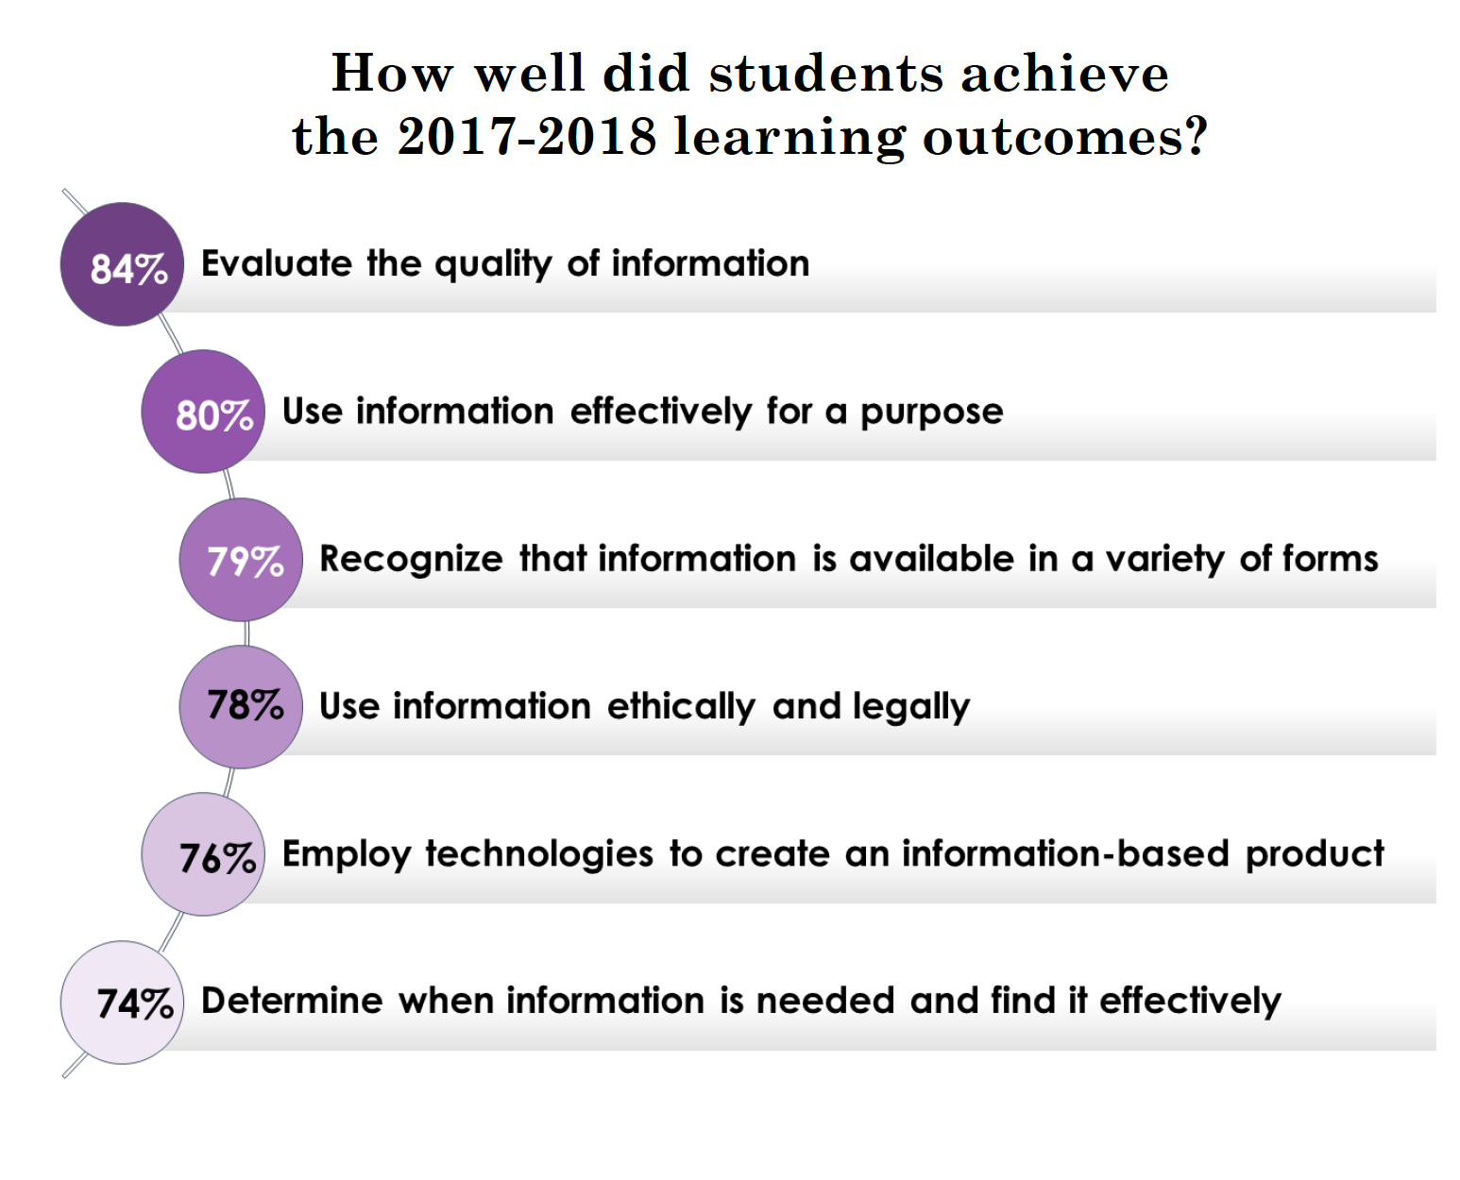
Notes:
What does assessment tell me – how students are doing by subscores

Slide 18
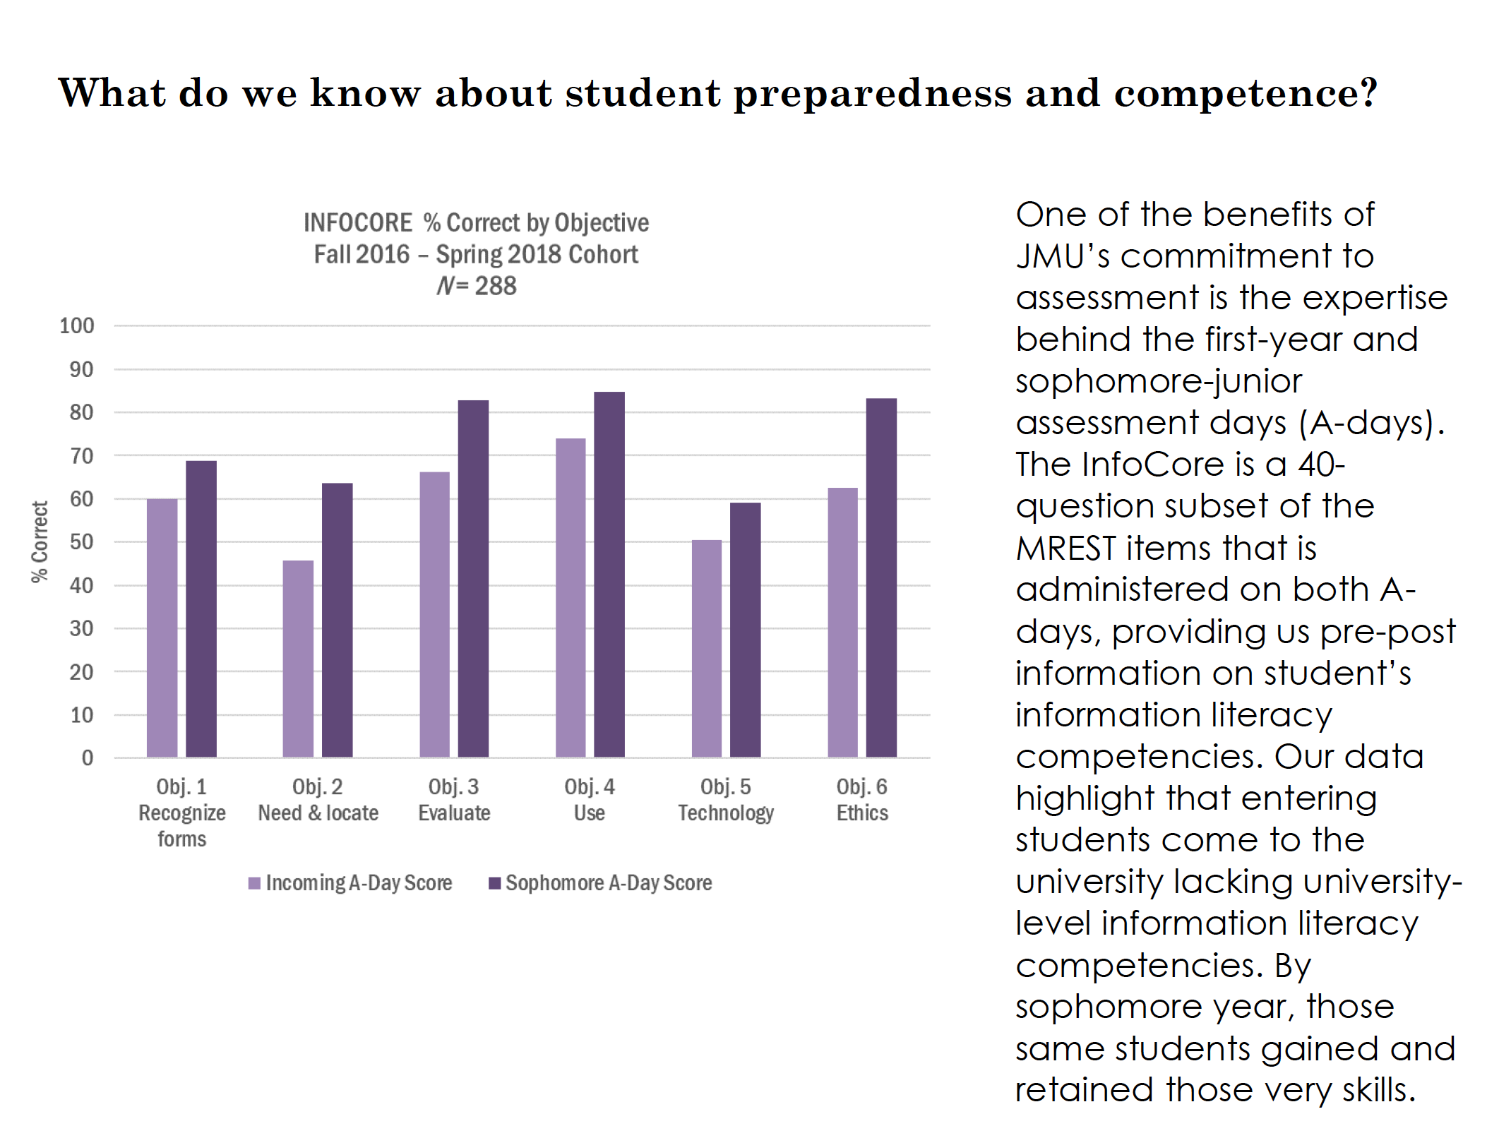
Notes:
PRE/Post test duplication effort helps us know something else that is related but different than MREST setting a competenciy.

Slide 19
Rubrics in the Disciplines
Institutional Context:
~15k, Public CSU, HSI
Dormant information literacy program + upcoming accreditation visit
A GE program without many signature assignments or standardized curriculum
More than half of the library’s instruction takes place in upper-division courses in the majors
----
Re-imagine, re-vision, re-invigorate,
Notes:
Introduce self. Our upcoming accreditation visit was from WASC where information literacy is one of the core competencies that are considered essential to the meaning of degree so there was certainly a surge in institutional interest

Slide 20
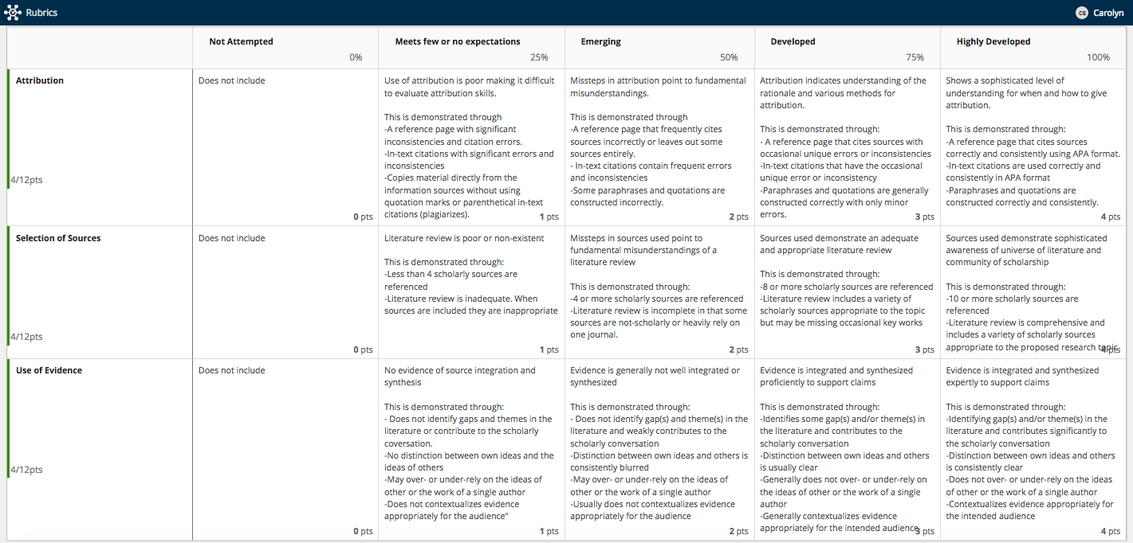
Notes:
It’s really tiny - sorry! But we established a relationship with some of our core undergraduate majors. Here’s a heavily modified rubric from Claremont Colleges that we used for our Psychology Capstone Papers. We developed this as a pilot to joint score papers between the department and librarians. Librarians took the lead for norming and facilitiating the rubric. We also used Campus Labs’ Baseline Rubric product which links to our peoplesoft student ID level. In our first semester we scored 50 papers across two sections. The results were intriguing and the department asked us to work with them again and we scored over 120 papers across 5 sections and 5 instructors. I’ll talk about the results and what we did next.

Slide 21
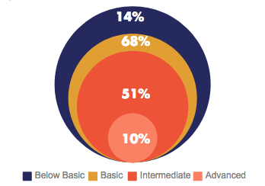
Psychology Capstone Papers
6 Faculty Librarians scored student work in pairs using Campus Labs Rubrics
Spring 2017 n=25
Fall 2017 n=63
Spring 2018 n=124
Fall 2018 TBD
In general, students found really great sources but didn’t demonstrate how to effectively integrate the sources into their literature reviews and fumbled their APA citations
Notes:
Very surprising to the faculty! Not surprising to librarians. We know students know how to find resources, yet faculty continued to want our library instruction to focus on database demonstrations.

Slide 22
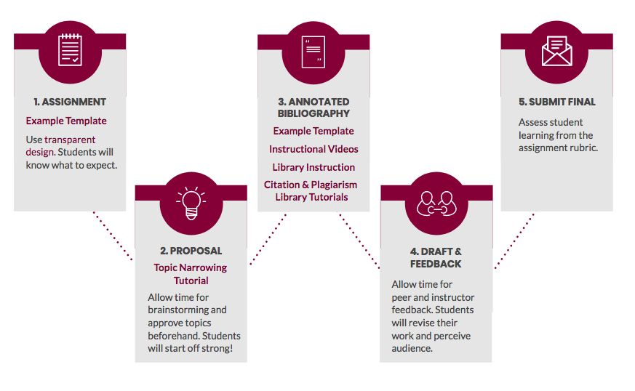
libguides.csudh.edu/psy490
Notes:
Our intervention. Lots of part time faculty in this department so we needed to make information literacy instruction easy and integrated into the curriculum. You can see the whole toolkit at the website above. Focused on scaffolding, assignment design, videos, and interactive tutorials, and an ancillary assignment. Toolkit approach - example from the toolkit

Slide 23
What’s next for us?
Instructors are submitting their assignments and teaching activities for inclusion into the toolkit
Rubric assessment is spreading! We just scored papers for Biology and are working with other departments on the creation and use of their own rubrics
Toolkits are spreading!
Adding on the NSSE module for information literacy and other IL assessments
We’re growing and so is our program - potential GE curriculum revision opportunities

Slide 24
In your group, review the institutional information and assessment goal. Decide which assessment tool you would use.
Then review the sample results and develop ideas about outcomes improvement based on those results. Take notes about your discussion to share at the end of the session.

